Slide 1
Guide to Successful Treatment with Clear Aligners

Slide 2
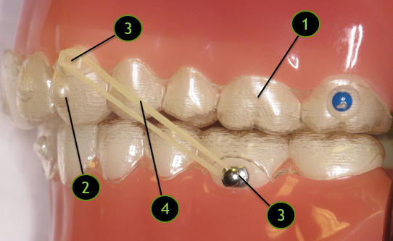
GETTING TO KNOW YOUR ALIGNERS
ALIGNERS
A series of custom plastic trays that gently shift your teeth into place.
ATTACHMENTS
Similar to the color of your teeth, these are small bumps that are bonded to specific teeth to aid in movement and to lock in the aligners.
BUTTON*
Clear or metal brackets that serve as anchor points for rubber bands.
*Note: Not all patients will have buttons during their treatment.
RUBBER BANDS/ELASTICS
Elastics are used to correct your bite and align your teeth. They must be worn as prescribed or they will not work correctly.

Slide 3
WEARING YOUR ALIGNERS
Your Invisalign® and Spark™ aligners must be worn for a minimum of 22 hours per day. We recommend that you wear your aligners all of the time, aside from when you are eating or brushing.
Your teeth will not move or “track” properly if you do not wear your aligners for the minimum 22 hours per day!
With your 100% effort, we can deliver 100% results!
22
22
22
22
22
22
22
22
22
22
22
22
22
22
22
22
22
22
22
22
22

Slide 4
WEARING YOUR ALIGNERS
Dr. Hack and Dr. O’Leary will give specific instructions about how many days you should wear each aligner. It is important that you wear each set for the prescribed amount of days, for the minimum of 22 hours per day.
For the duration of your treatment, we recommend saving one previous set of aligners when moving on to a new pair just in case you accidentally lose one.
Please make certain that your upper and lower tray numbers match. The tray number is located on the molar region of each individual aligner.

Slide 5
WEARING YOUR ALIGNERS
In the case that your next appointment is scheduled on a date after you are due to change to your next set of aligners, you can simply continue wearing the tray for a little bit of extra time!
If for any reason you miss an appointment, there is no harm in wearing your aligner trays a few additional days or weeks.
Patients should never stop wearing their trays unless they are instructed by the doctor to do so, or until retainer(s) are received at the end of treatment.
IN THE EVENT THAT:
You reach the end of your aligner tray sequence,
You miss an appointment, or
Your next appointment does not coincide with the day you are due to change into your next tray,
PLEASE STILL CONTINUE TO WEAR YOUR TRAYS!

Slide 6
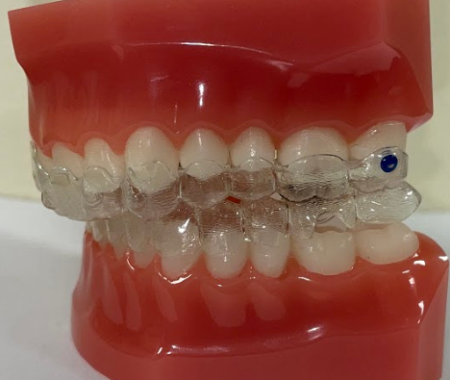
SEATING YOUR ALIGNERS
It is normal for the trays to feel very tight when first putting in a new set, if for some reason you are experiencing poor fit with your trays, please call the office for further instruction.
When you insert your trays they should fit without any gaps between the aligner and your teeth.
Trays not fully seated

Slide 7
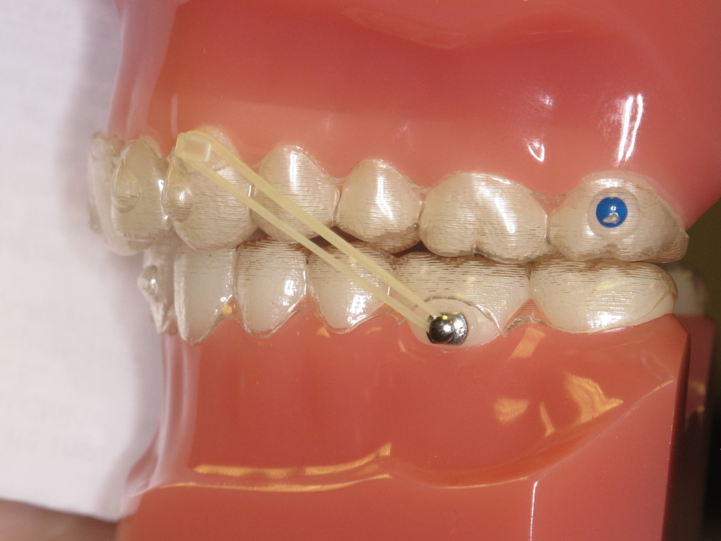
ELASTICS/RUBBERBAND COMPLIANCE
We ask some patients to wear elastics for a period of time during their treatment in order to align their bite.
It is extremely important to wear your elastics as instructed. Without good elastic wear, treatment time will be extended, and we may not get the result we want.
An elastic anchored by a metal button on the lower arch and a clear button on the upper arch

Slide 8
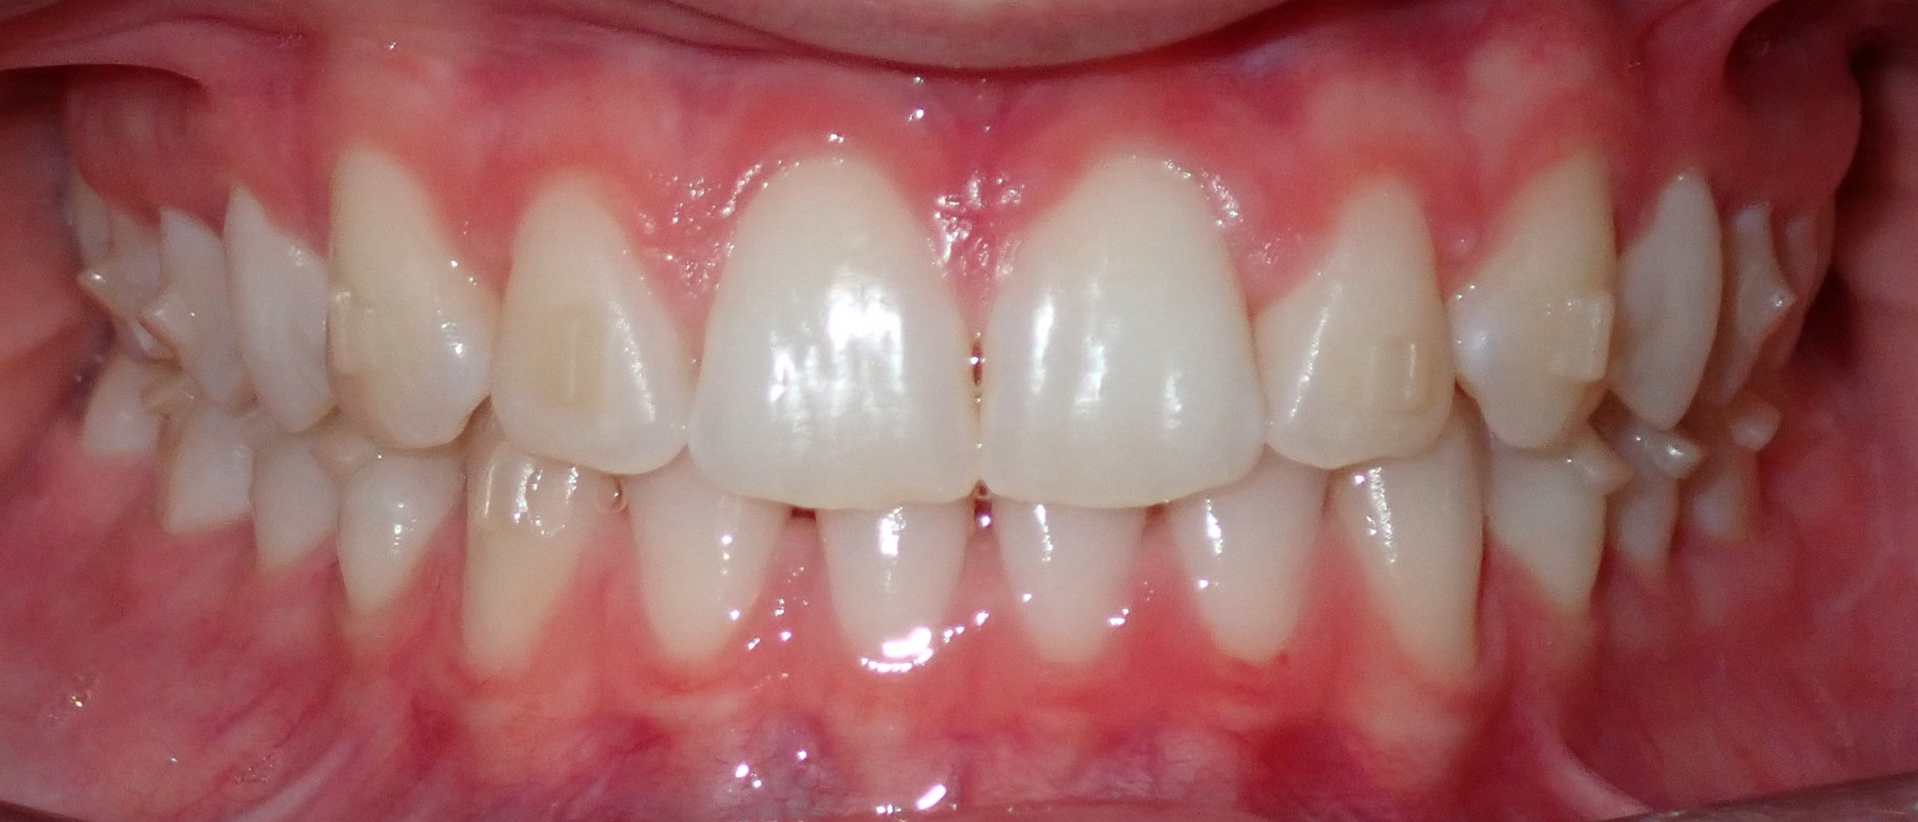
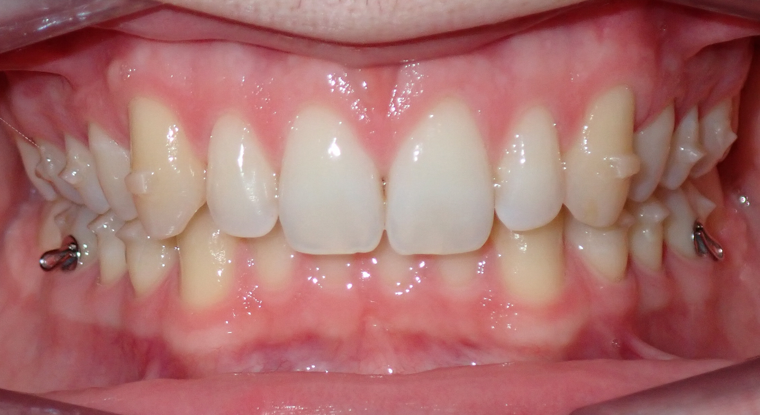
CARE AND CLEANING
Brushing and Flossing
Treatment with aligners does not change the way that you brush and floss. Any type of soft-bristled toothbrush will work. Electric toothbrushes work best.
Angle your toothbrush around any attachments and/or buttons you may have, making small circles along the gum line to ensure good plaque removal.
Patient in treatment with attachments
Patient in treatment with attachments and buttons

Slide 9
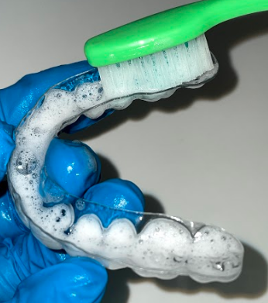
CARE AND CLEANING
Cleaning Your Aligners
We recommend brushing your aligners – inside and outside – with mild dish soap and lukewarm water.
Aligners should be cleaned at least twice a day.
*DO NOT clean your aligners in hot or boiling water or they will become distorted and won’t fit properly!
Cleansing with mild soap and lukewarm water

Slide 10
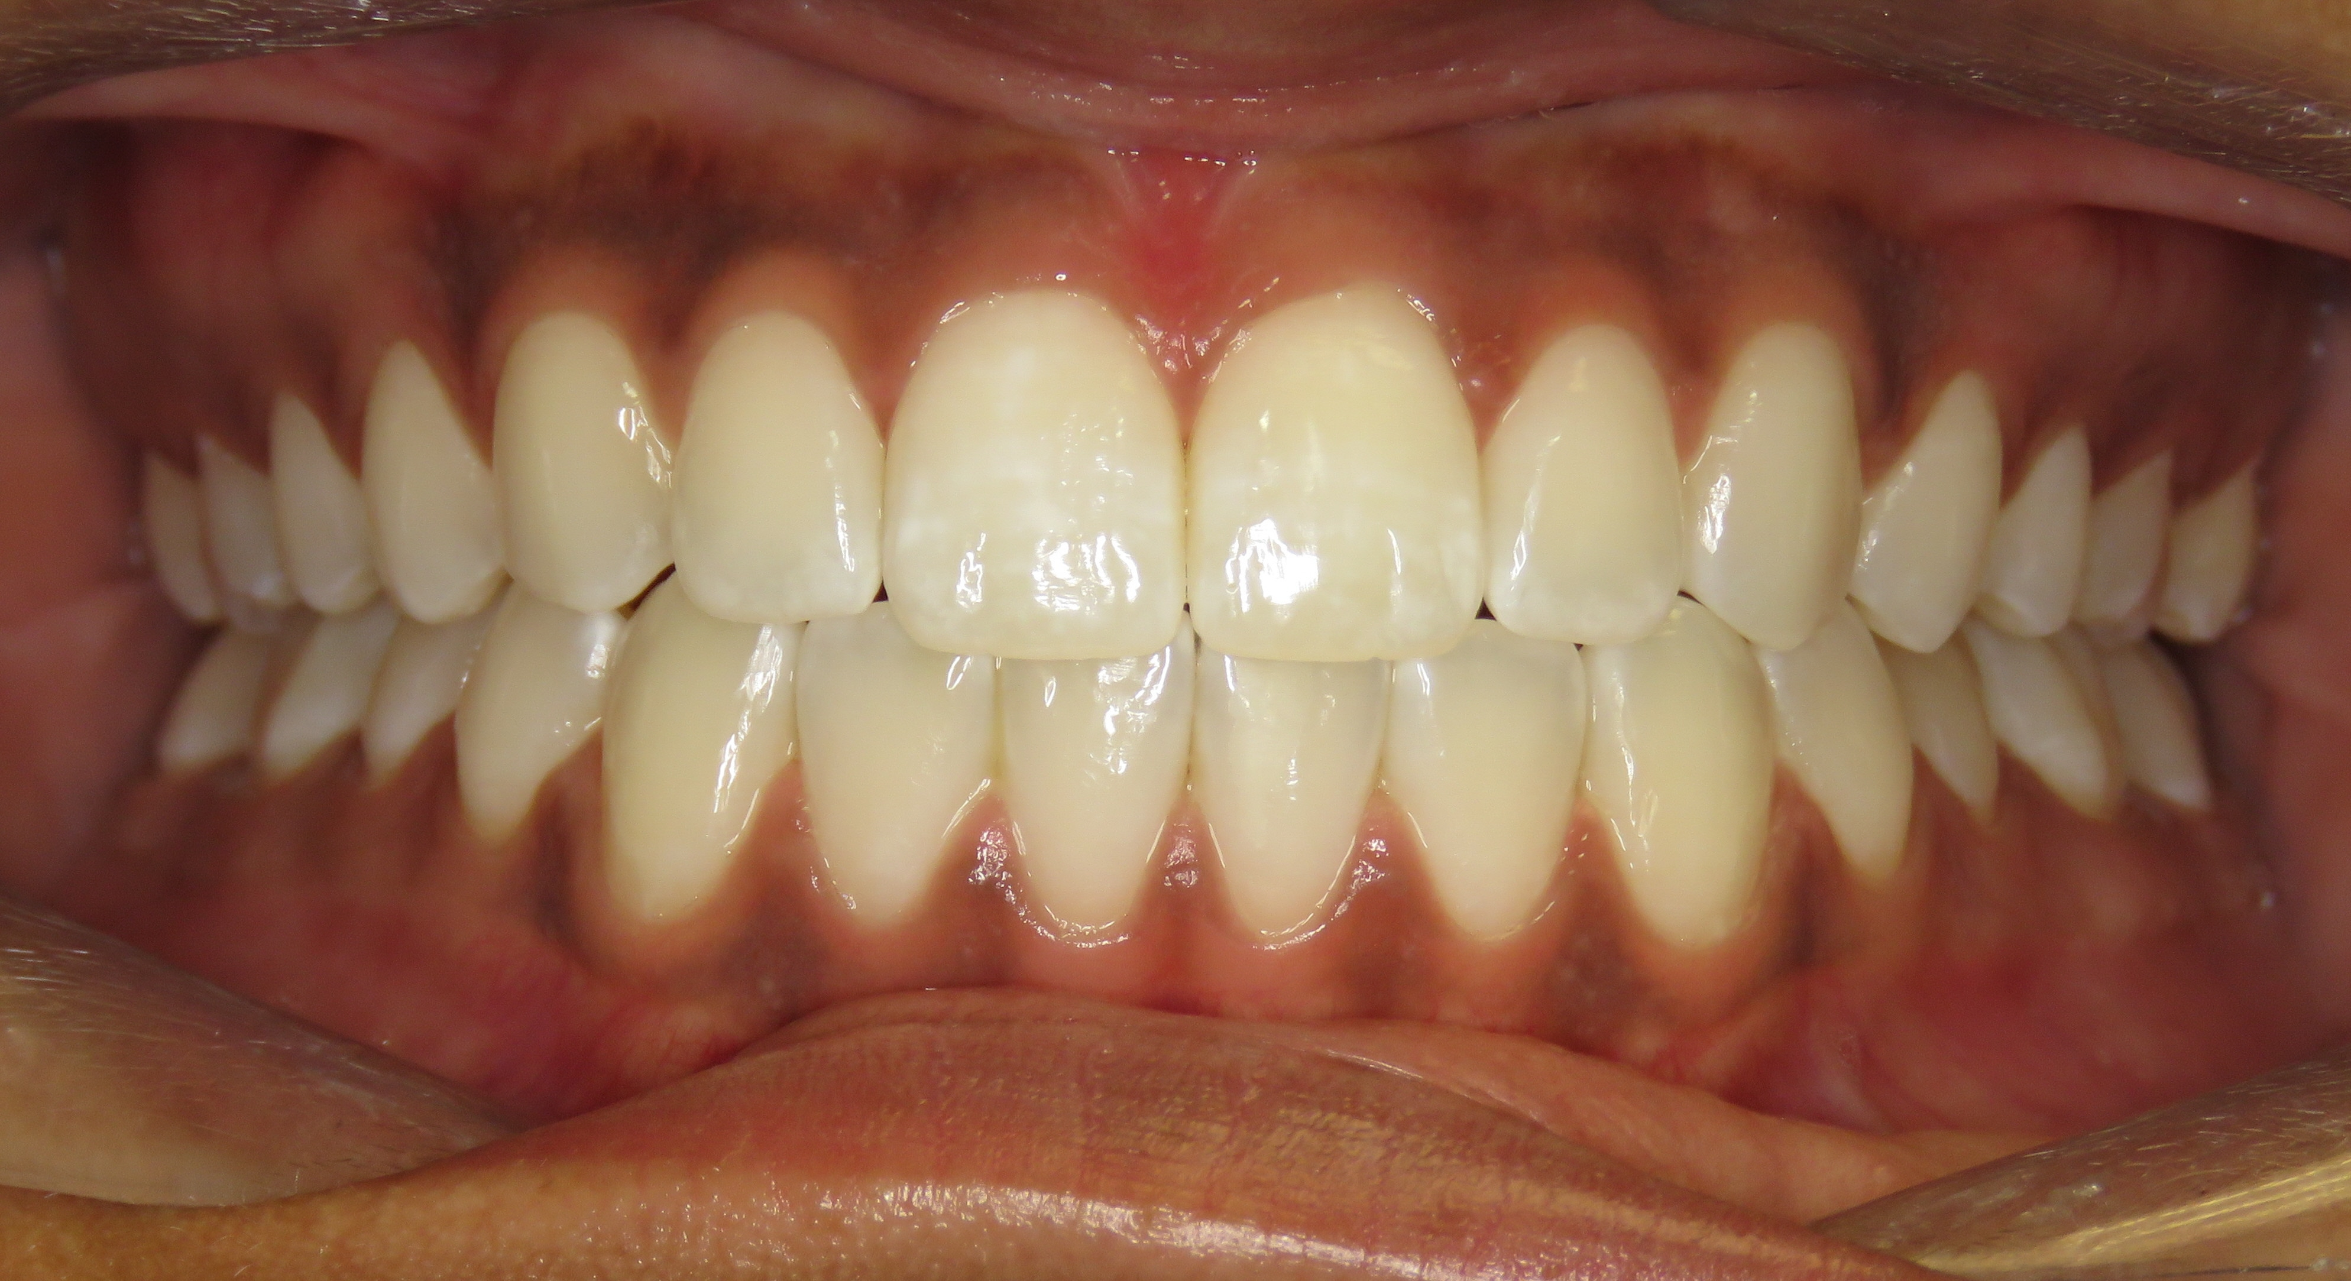
PRACTICING GOOD ORAL HYGIENE
If you brush and floss your teeth properly and consistently clean your aligners, then you will end treatment with a beautiful, healthy smile!
Effort = Results! By putting forth your best effort to practice good oral hygiene, you will get the best results!
Patient after finishing Invisalign® treatment

Slide 11
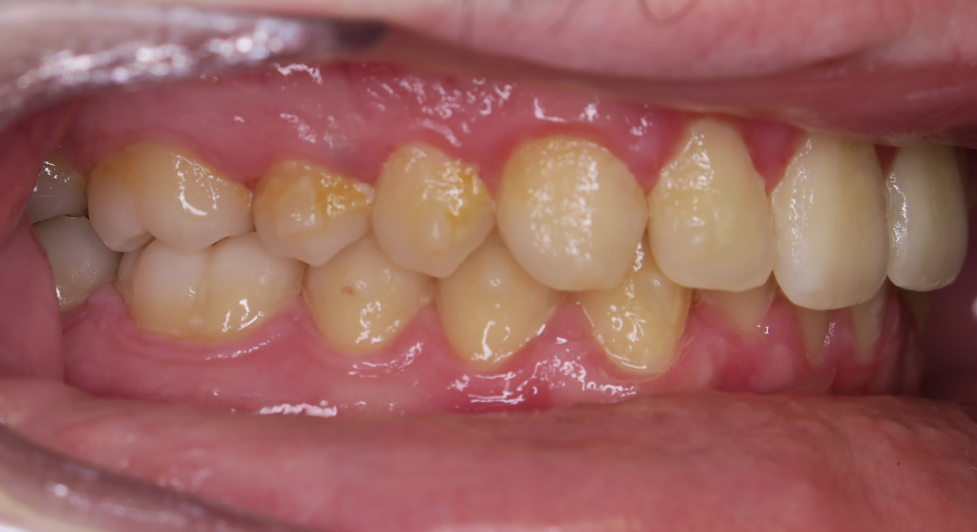
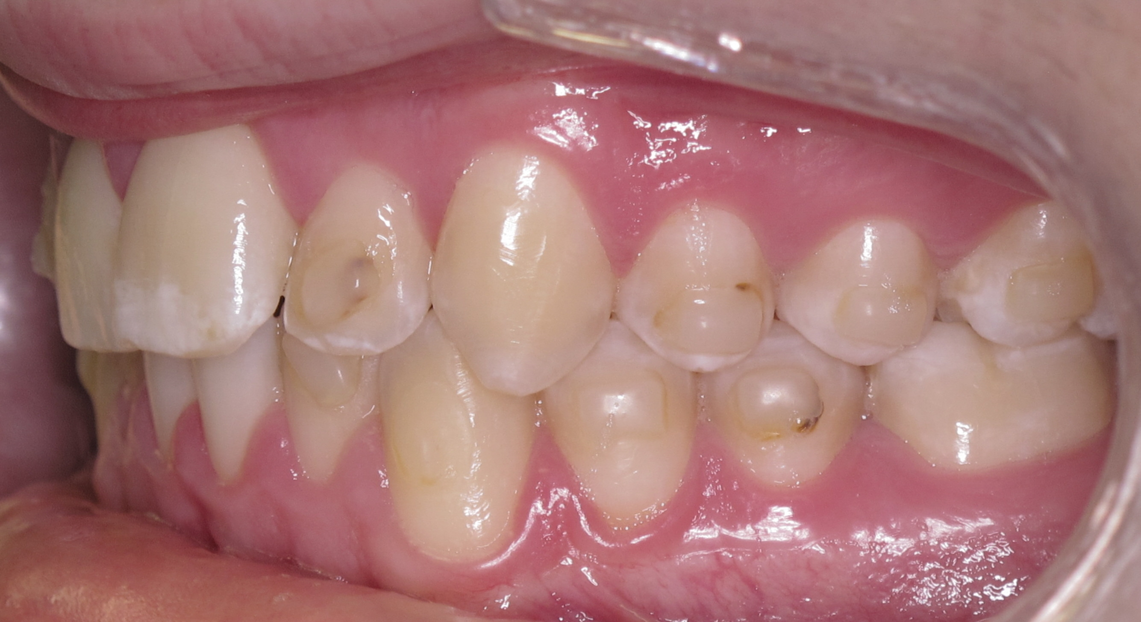
PRACTICING GOOD ORAL HYGIENE
Without brushing and flossing, PLAQUE BUILD-UP, DECAY, DECALCIFICATION, and STAINING can happen. These marks are PERMANENT and will not come off your teeth! Practicing good oral hygiene will prevent your teeth from looking like this…
Decay, decalcification, and staining around and underneath attachments as a result of poor oral hygiene
Poor oral hygiene causing plaque build-up around attachments

Slide 12
CARE AND CLEANING
Eating and Drinking
Please note that there are no eating restrictions while you are in treatment! ☺
Always remove your aligners before eating. Eating with your aligners can cause distortion and staining.
DO NOT chew gum or bite your fingernails, pens or pencils, as this can potentially impact your tooth movement.
Remove aligners before drinking any beverage other than water. Dark beverages – including tea, coffee, cola, beer, and wine – may stain your aligners.
DO NOT drink hot beverages while wearing aligners because it can warp or distort them.
It is important to brush AND floss after every meal before re-inserting your aligners so that food and bacteria don’t get trapped inside of them.

Slide 13
CARE AND CLEANING
Talking with Aligners
You may briefly experience a change in speech while you adjust to wearing your new aligners. This may last up to a day or two.
To speed up the adjustment process, practice enunciating your words or reading out loud. Since each aligner is similar in shape and thickness, switching to a new aligner should not cause any speech issues.

Slide 14
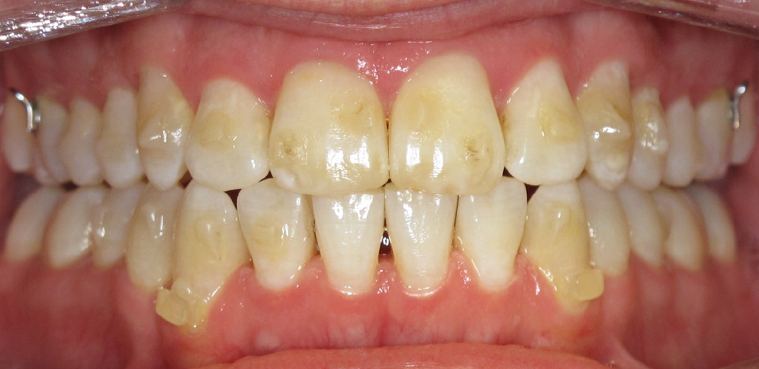
CARE AND CLEANING
Smoking
Tobacco products will permanently stain both aligners and attachments. Tobacco use can also lead to staining on your teeth.
Stains that can result from smoking or poor oral hygiene

Slide 15
SOLUTIONS FOR SORENESS AND/OR DISCOMFORT
Awkward-Feeling Bite
It is completely normal for your bite to sometimes feel a little bit “off” during your treatment. This happens because your teeth are constantly moving to be in their correct position.

Slide 16
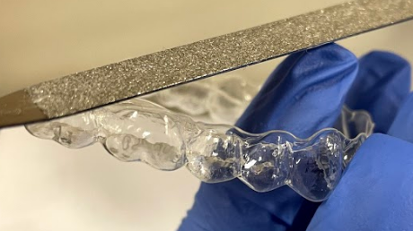
SOLUTIONS FOR SORENESS AND/OR DISCOMFORT
Rough Edges on Aligners
If you feel a rough edge on an aligner and it is irritating your tongue or cheek, gently use an emery board/nail file to smooth the edge.
Nail file used to smooth a rough edge on an aligner

Slide 17
SOLUTIONS FOR SORENESS AND/OR DISCOMFORT
Soreness
It is normal to experience some soreness or tooth tenderness each time you switch to a new aligner.
Soreness should last no more than 1-3 days.
You can take your regular over-the-counter medication, such as Tylenol or ibuprofen, to relieve any discomfort.
Eating softer foods for a few days may also help in alleviating soreness.

Slide 18
PROBLEMS AND AT-HOME SOLUTIONS
Missing Attachment
If an attachment falls off, there is no need to call the office. Continue to wear your aligners as prescribed and the doctor will evaluate the need to replace the missing attachment at your next regularly scheduled appointment.

Slide 19
PROBLEMS AND AT-HOME SOLUTIONS
Lost Aligner
If you lose the aligner that you are currently wearing, go back to your previous aligner and call our office for further instruction.
If you lose multiple aligners, please call our office so we can order replacement aligners for you.

Slide 20
EXTRA CARE VISITS
Extra care visits are needed when a button comes off or your aligners are not fitting properly.
For our Phase I patients who have a mixture of permanent teeth and baby teeth, if a baby tooth becomes loose and affects how your aligners fit or prevents you from being able to wear the tray, please call our office as soon as possible.
Please keep in mind that these extra care visits are not always available at the most convenient times.

Slide 21
EMERGENCIES
Clinical assistants and/or the doctors are on-call for traumatic emergencies 24/7. Injuries to the teeth and face are considered emergencies. In the event of an emergency after normal business hours, call our office to be connected with the emergency pager service.
As a courtesy, we ask that patients and parents do not call our pager service for a non-emergent reason. Non-emergent examples would include calls to cancel or reschedule appointments, or to be seen solely for convenience outside of school or work hours. If the patient is experiencing the common soreness of orthodontic treatment such as a poking wire or if a bracket has fallen off, please refer to the At-Home Solutions page(s), and call our office during normal business hours.

Slide 22
HOW TO CONTACT US:
WATERFORD
860.443.1827
NORWICH
860.886.7777

