Slide 1
Congratulations on Completing Your Orthodontic Treatment!

Slide 2
RETENTION IS FOR LIFE!
At the end of your appointment today, you will have received a set of removable retainers. Following the retainer instructions given to you is very important to keep your smile as perfect as it is today!
Your teeth have memory, so if you do not wear your retainers, then your teeth will move back to the way they were before you started treatment!

Slide 3
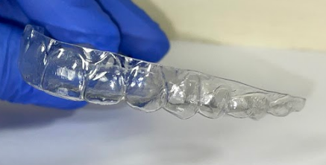
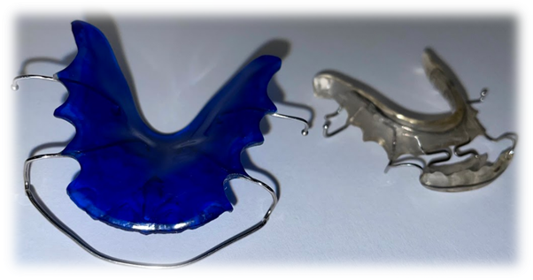
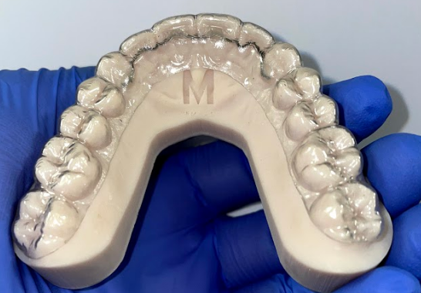
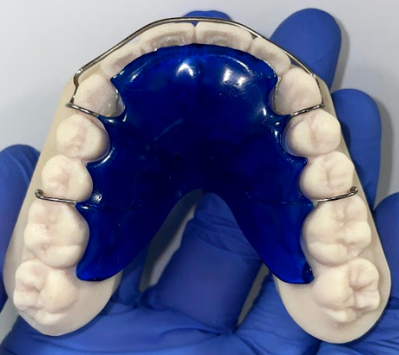
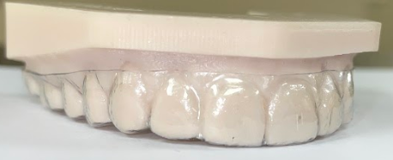
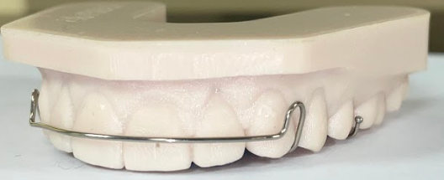
RETAINERS
Retainers are a removable appliance worn as prescribed to hold orthodontic movement. Depending on your treatment, you received either a clear Vacuum Formed Retainer (VFR) to hold alignment, or an Acrylic Hawley Retainer (ACH) to hold alignment and expansion.
VFR’s
ACH’s

Slide 4
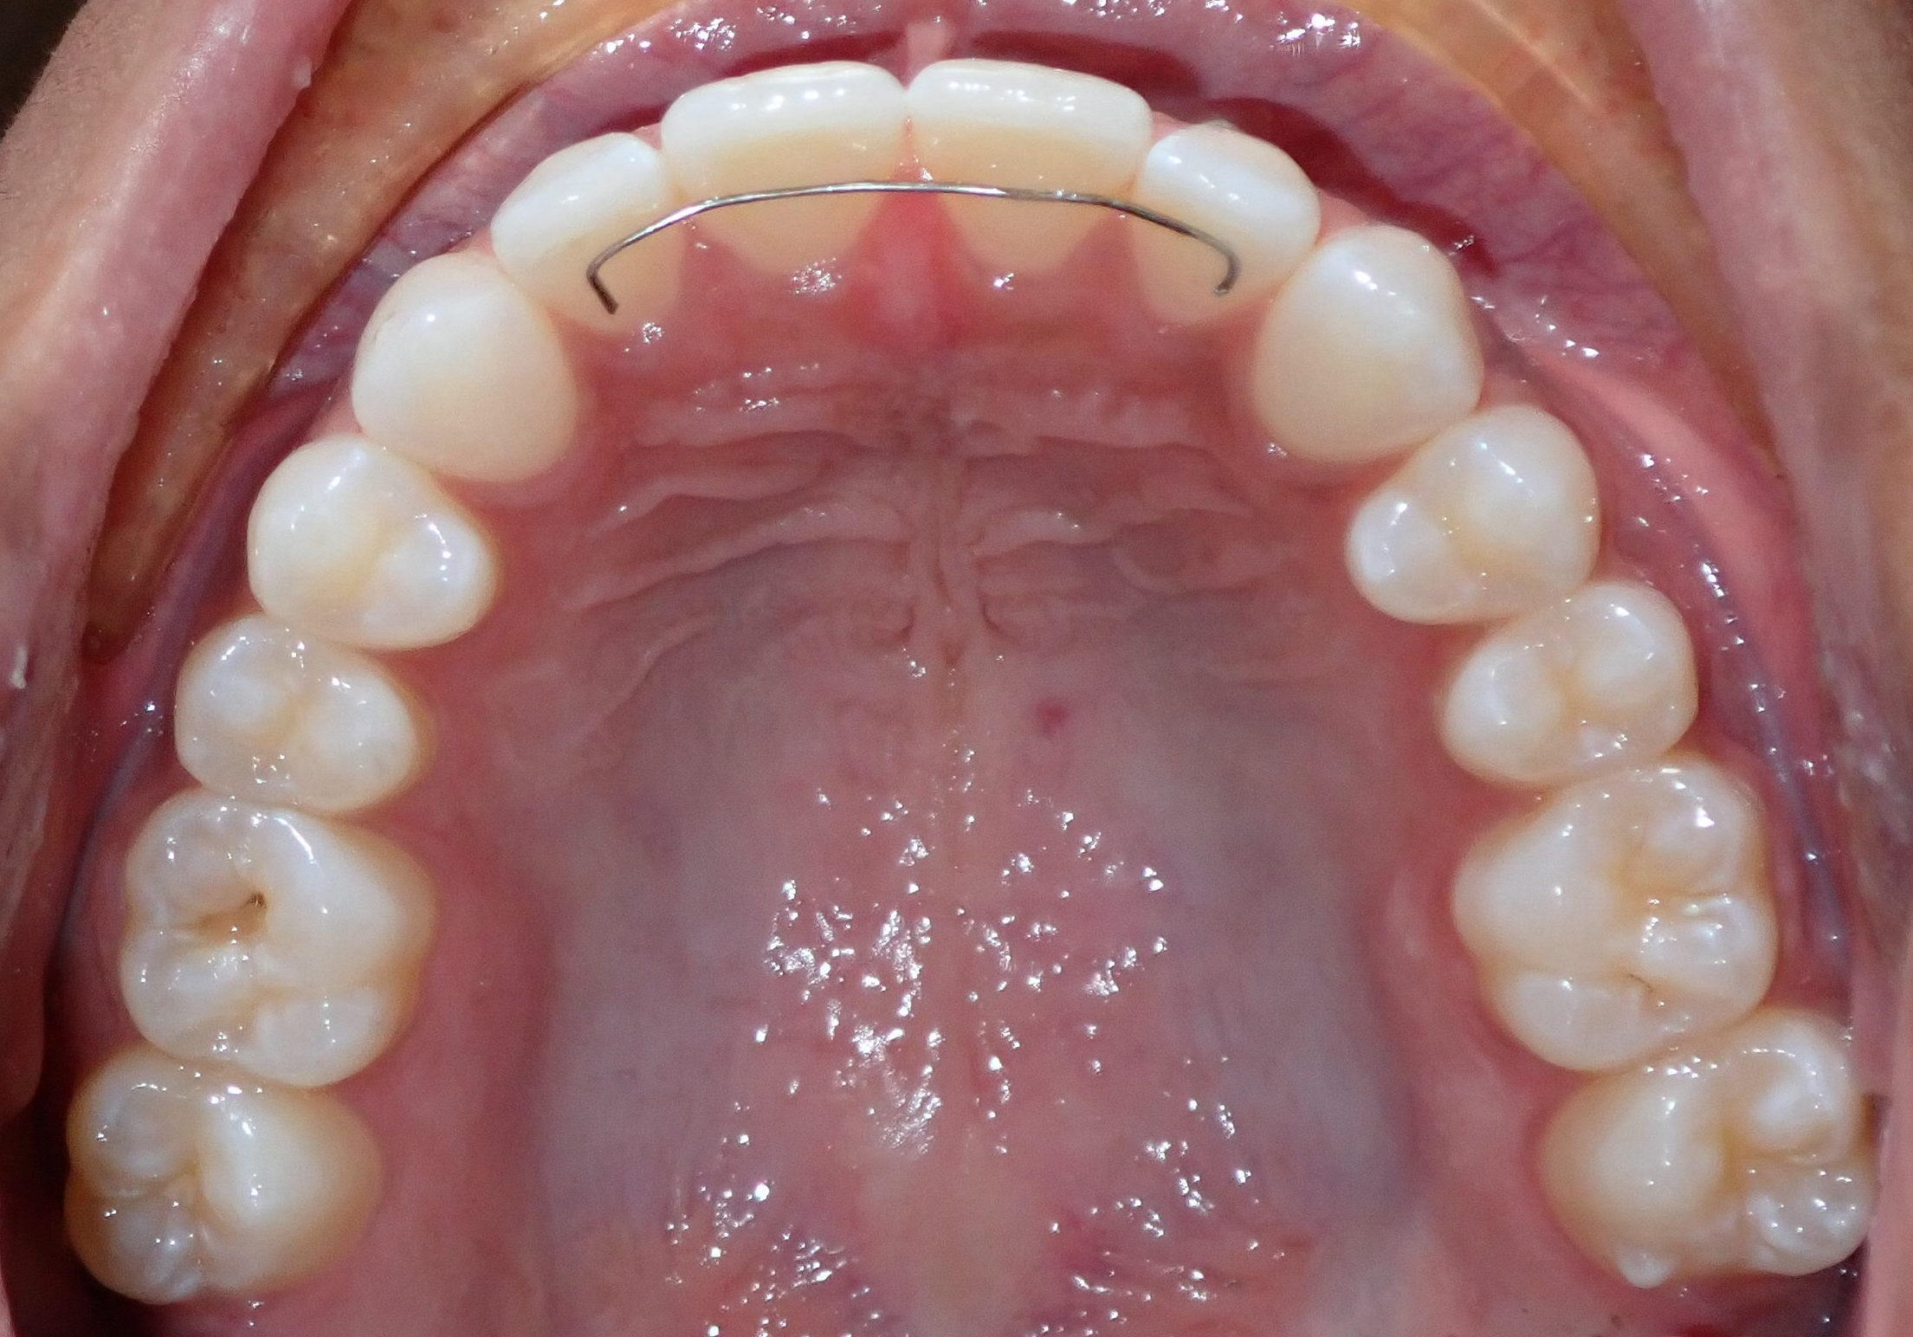
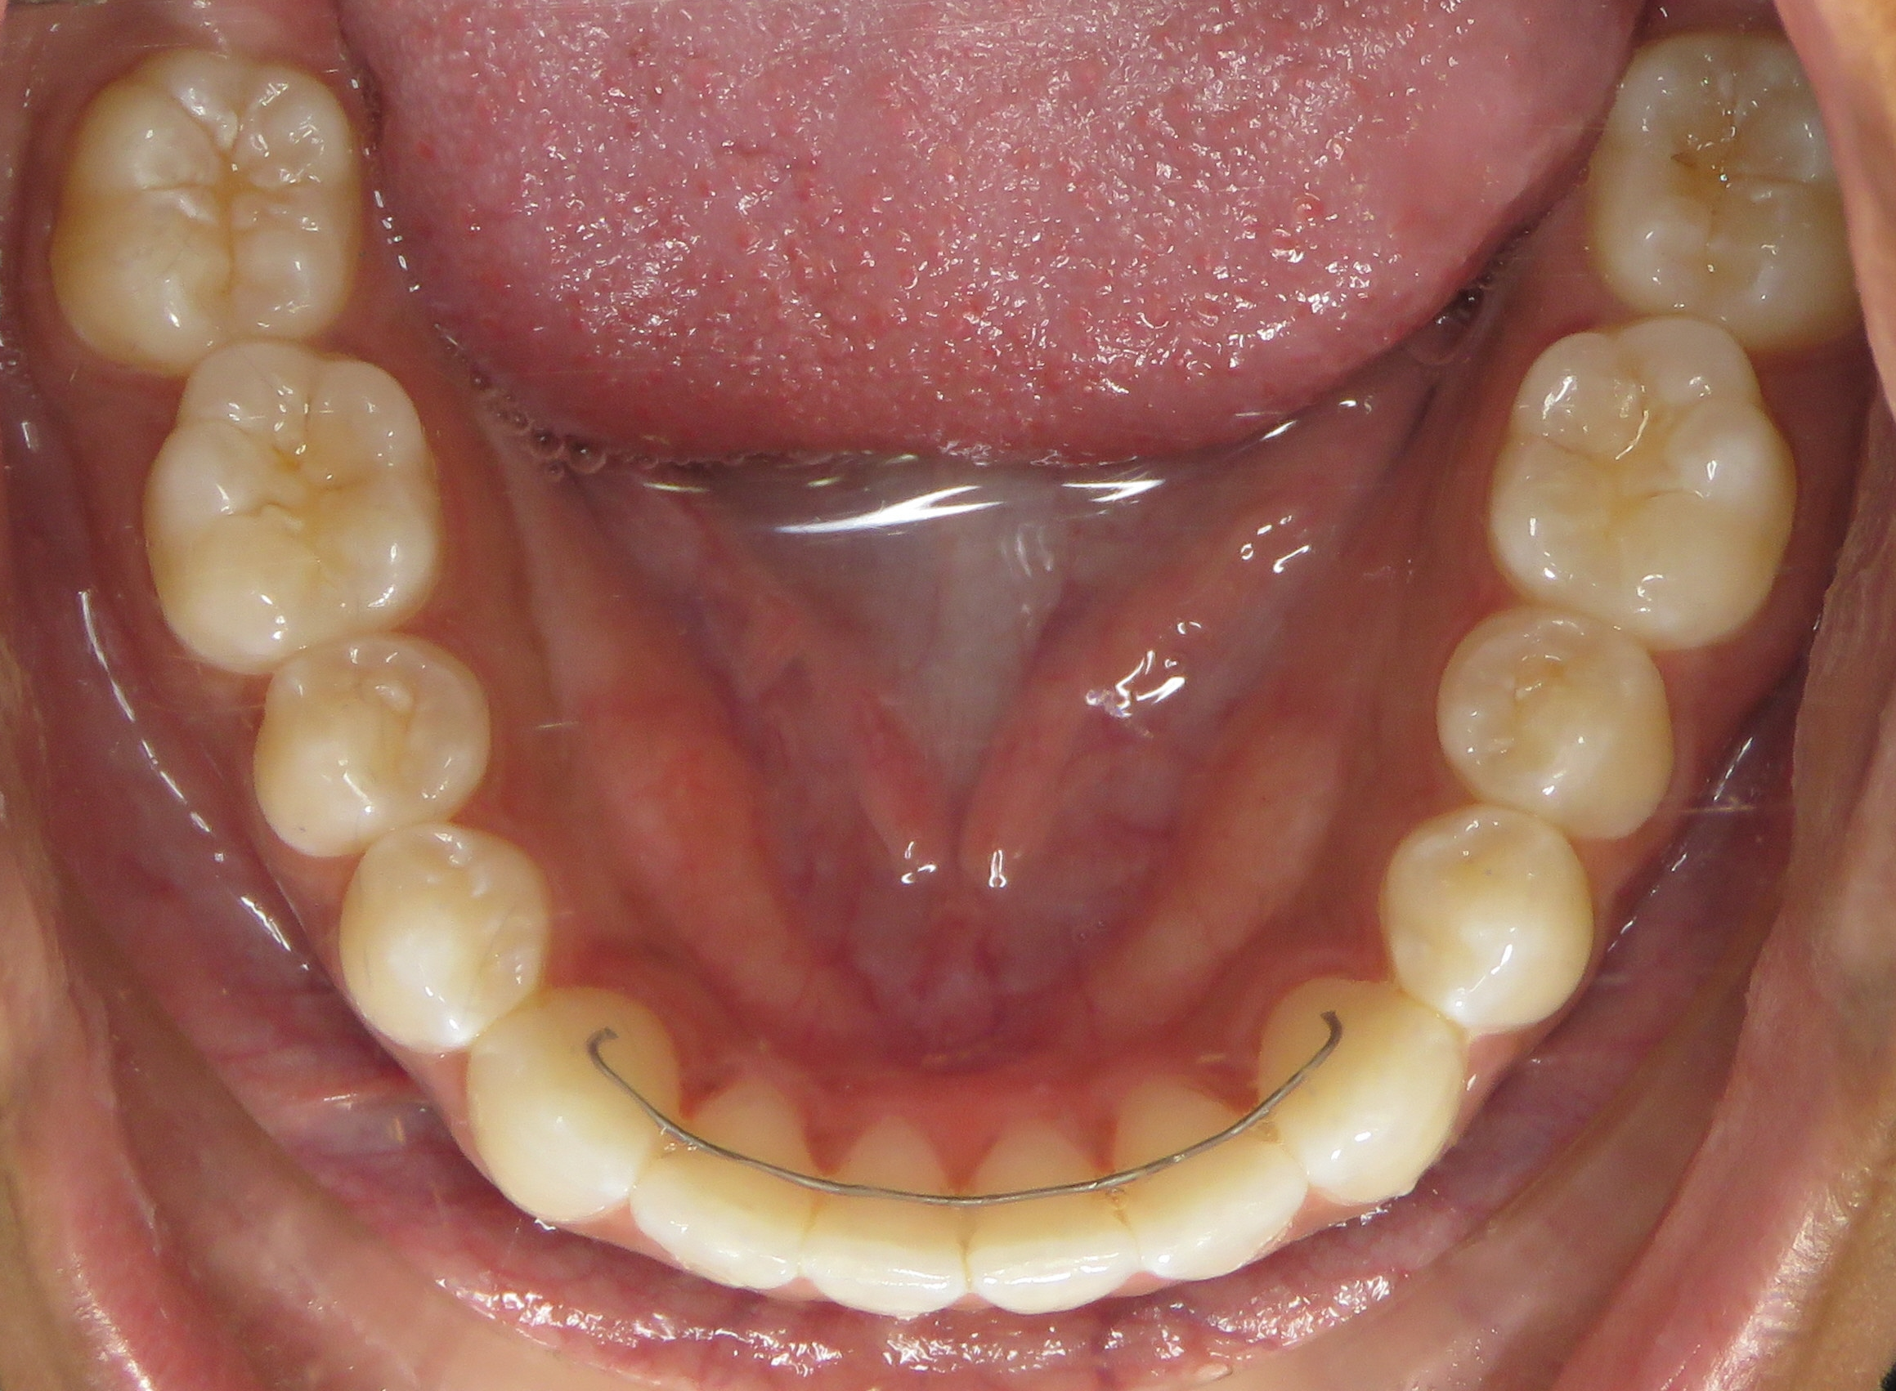
FIXED LINGUAL RETAINER (FLR)
Some patients receive a fixed retainer that is bonded to the inside of the teeth.
These customized wires hold the alignment of previously crowded teeth, or prevents a previous space from re-opening.
The assistant will show you how to properly floss between and around your bonded retainers with threader floss.
This type of retainer does not replace your removable retainer! It is worn in conjunction with a removable retainer for best results.
Patient with upper and lower fixed retainers

Slide 5
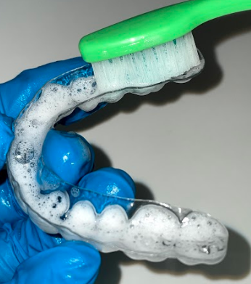
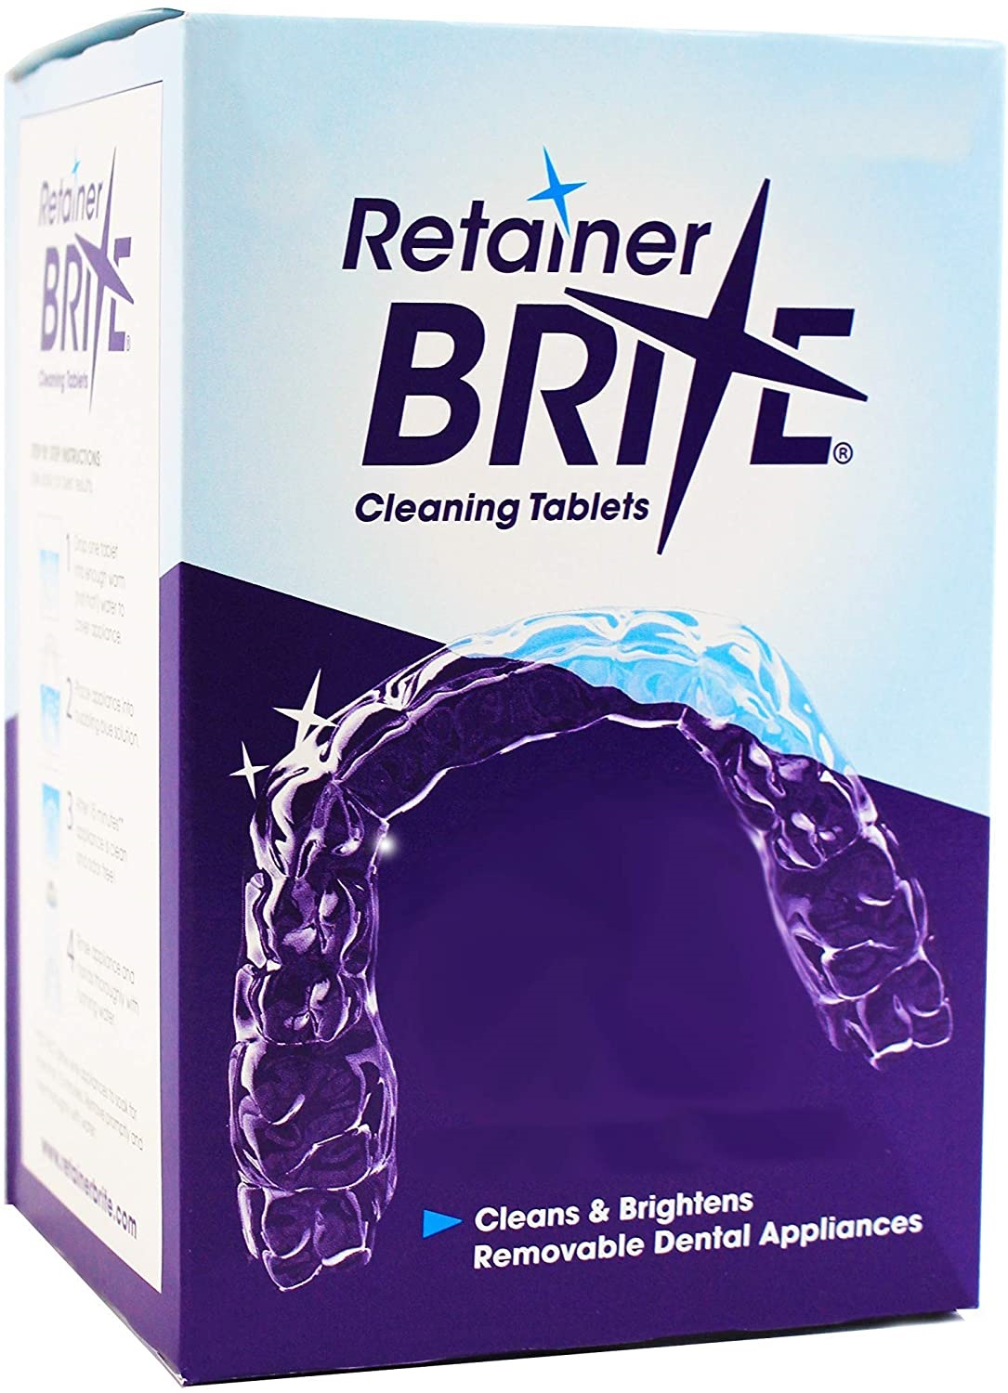
CLEANING YOUR RETAINERS
Your retainers will need to be cleaned daily- in the morning when you remove them and at night before you put them back in.
You can use a toothbrush and toothpaste or mild dish soap (like Dawn©) with lukewarm water to clean both the inside and outside of your retainers.
You can also purchase retainer cleaning tablets if needed.
Cleansing with mild soap and lukewarm water
Example of cleaning tablets

Slide 6
RETAINER WEAR
You must wear your retainer EVERY SINGLE NIGHT in order to maintain alignment, space closure, and/or the new jaw relationship we have created with the braces or aligners.
You must wear your retainer for the amount of hours that Dr. O’Leary or Dr. Hack have prescribed for the best results.
If you experience any issues with how your permanent or removable retainer fits or feels, please call our office to schedule an appointment to adjust them.

Slide 7
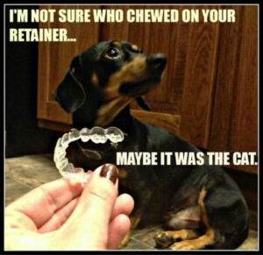
RETAINERS AND PETS
KEEP YOUR RETAINERS OUT OF REACH OF ALL PETS!!! RETAINERS ARE YOUR DOG’S MOST EXPENSIVE CHEW TOY!
This occurs more often than you may think. Dogs and other animals can be attracted to the scent of the plastics and acrylics used, as well as your saliva. Be sure to keep your retainer in a safe space when you are not wearing it!

Slide 8
LOST OR DAMAGED RETAINERS
Your treatment fee included your active treatment as well as the set of retainers you received today. If you lose or damage these retainers, there will be fees for replacement retainers.
Laboratory fees for replacement retainers range anywhere from $125 - $400, so please take good care of them! The longer you go without your retainer(s), the more potential there is for your teeth to shift.
The best way to avoid losing or damaging your retainers is to keep them in your case if they are not in your face!

Slide 9
EVEN WITH THE BEST CARE, RETAINERS CAN STILL BREAK
Removable retainers are made to last you a lifetime. However, some patients with clenching or grinding habits will go through retainers a lot quicker. If you feel that your retainers are thinning or are beginning to have holes in them, please call our office right away!

Slide 10
WHAT TO EXPECT NOW
For all future appointments, please bring your removable retainers with you.
Permanent fixed retainers are guaranteed for 12 months and are repaired at no charge during this 12 month period.
After one year, we do have an office visit fee of $100 for any additional appointments.

Slide 11
REMINDERS FOR RETAINER COMPLIANCE
DO ☺
DON’T ☹
Call us immediately if your retainer is lost, damaged, or not fitting properly
Call us immediately if your permanent retainer breaks
Remove your retainer while eating
Wear your retainer as instructed so your teeth don’t shift
Continue to visit your general dentist on a regular basis
Wrap your retainer in a napkin while eating
Put your retainer in your shirt or pants pocket
Leave your retainer near heat, including sunlight, heaters, in a hot car, etc.
Boil, microwave, or clean your retainer with extremely hot water
Leave your retainer out of its case

Slide 12
ORTHODONTIC TREATMENT IS A LIFETIME COMMITMENT! ONLY YOU CAN KEEP YOUR TEETH STRAIGHT FROM THIS POINT ON BY WEARING YOUR REMOVABLE RETAINERS! RETAINERS + YOU = A GUARANTEED INVESTMENT

Slide 13
HOW TO CONTACT US:
WATERFORD
860.443.1827
NORWICH
860.886.7777

