Slide 1
Guide to Successful Treatment

Slide 2
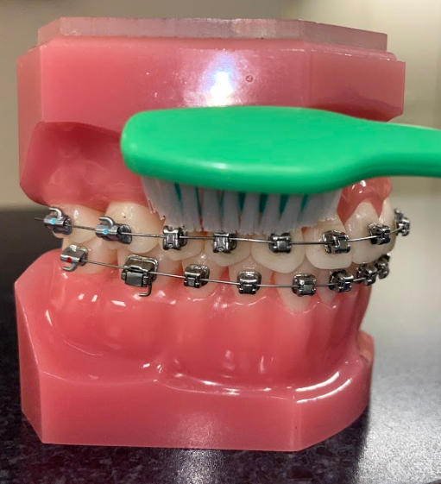
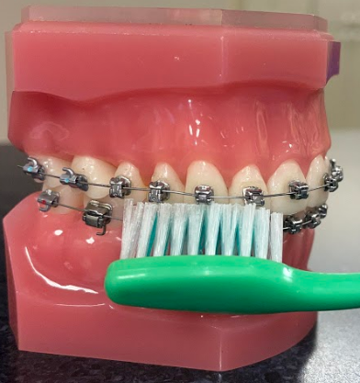
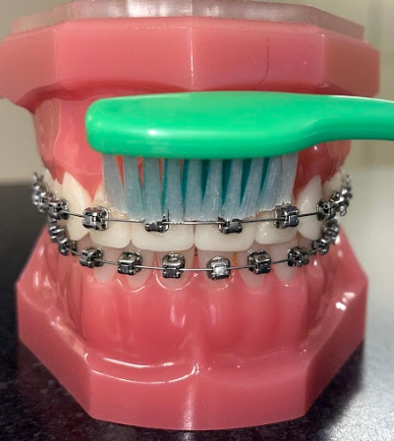
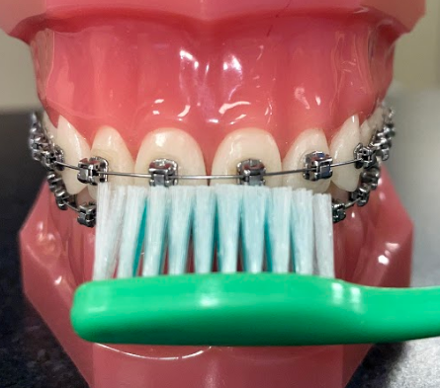
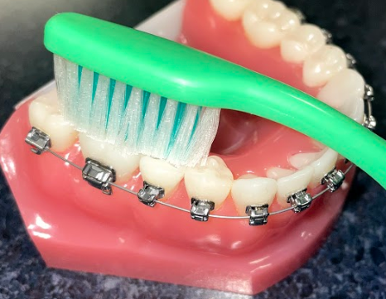
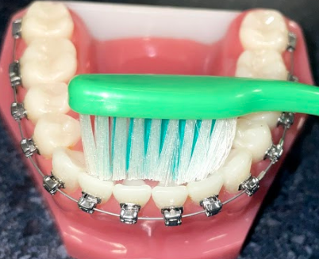
CLEANING YOUR TEETH WITH BRACES
Brushing
Brush in circular motions and angle your toothbrush as pictured below.
Brush 3 times a day and/or after meals.
After brushing at night, use a pea-sized amount of your PreviDent® toothpaste on all of your teeth, spitting out the excess. Do not rinse, eat, or drink for at least 30 minutes after using PreviDent®.
Right & left sides above braces
Right & left sides below braces
Center above braces
Center below braces
Right & left sides on biting surfaces
All inner (tongue-side) surfaces

Slide 3
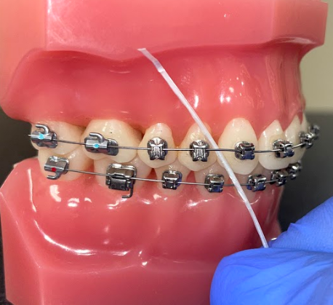
CLEANING YOUR TEETH WITH BRACES
Flossing
Threader floss will assist you in flossing between your braces and under your wires. Without flossing, your gums may become red and puffy, which can lead to gingivitis!
Threader Floss

Slide 4
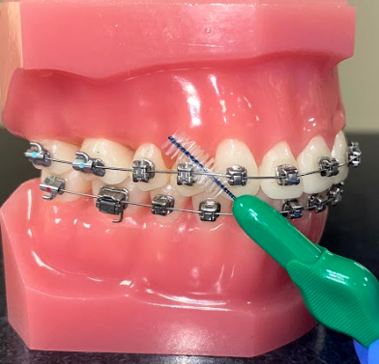
CLEANING YOUR TEETH WITH BRACES
Interproximal Brushes
Another option for cleaning in between your braces is an interproximal brush. These small tools are very handy and convenient when you are on-the-go and unable to immediately brush or floss.
Interproximal Brush

Slide 5
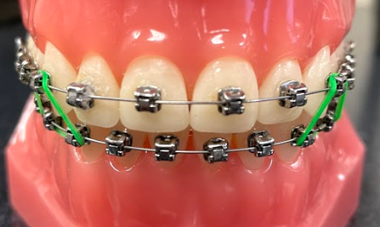
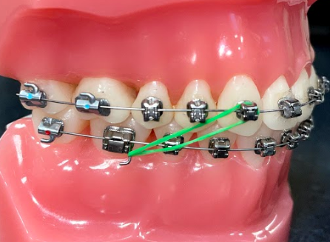
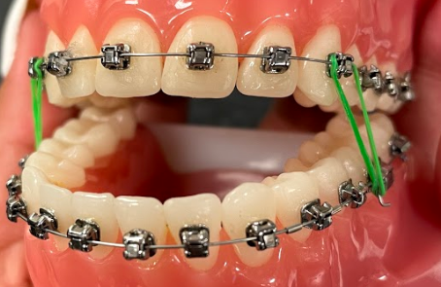
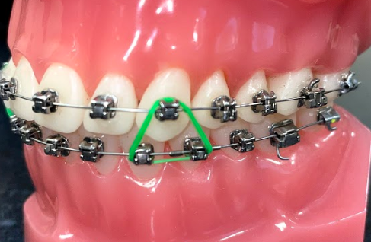
ELASTICS/RUBBERBAND COMPLIANCE
We ask some patients to wear elastics for a period of time during their treatment in order to align their bite.
It is extremely important to wear your elastics as instructed by the assistant. Without good elastic wear, the amount of time that your braces are on will be extended, and we may not get the result we want.
With your 100% effort, we can deliver 100% results!

Slide 6
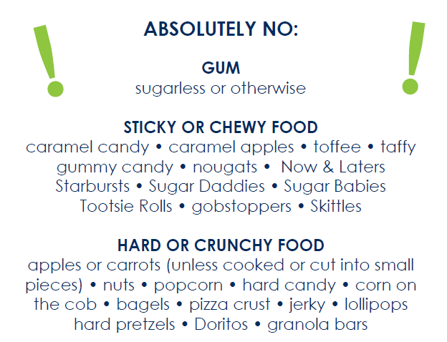
FOODS YOU SHOULD NOT EAT DURING YOUR TREATMENT

Slide 7
THINGS TO AVOID WHILE IN BRACES

Slide 8
PROTECTING YOUR TEETH AGAINST EROSION
Pictured below are common foods and drinks containing dietary acids that can erode tooth enamel. You can, of course, still eat and drink these, just be cautious!
©2016 P&G

Slide 9
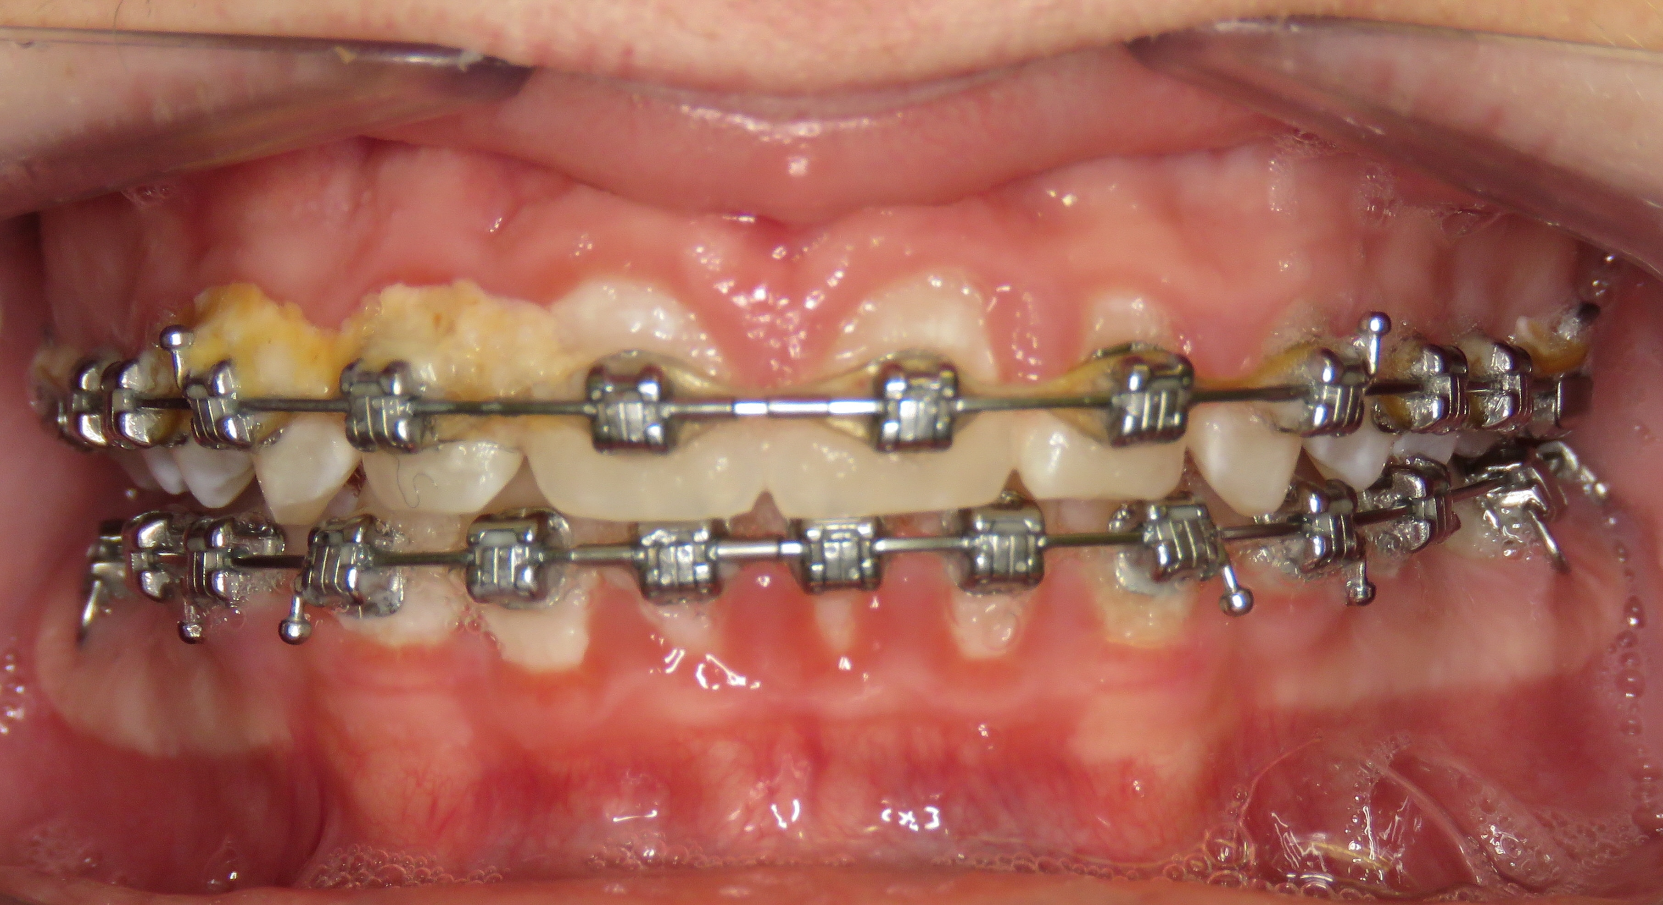
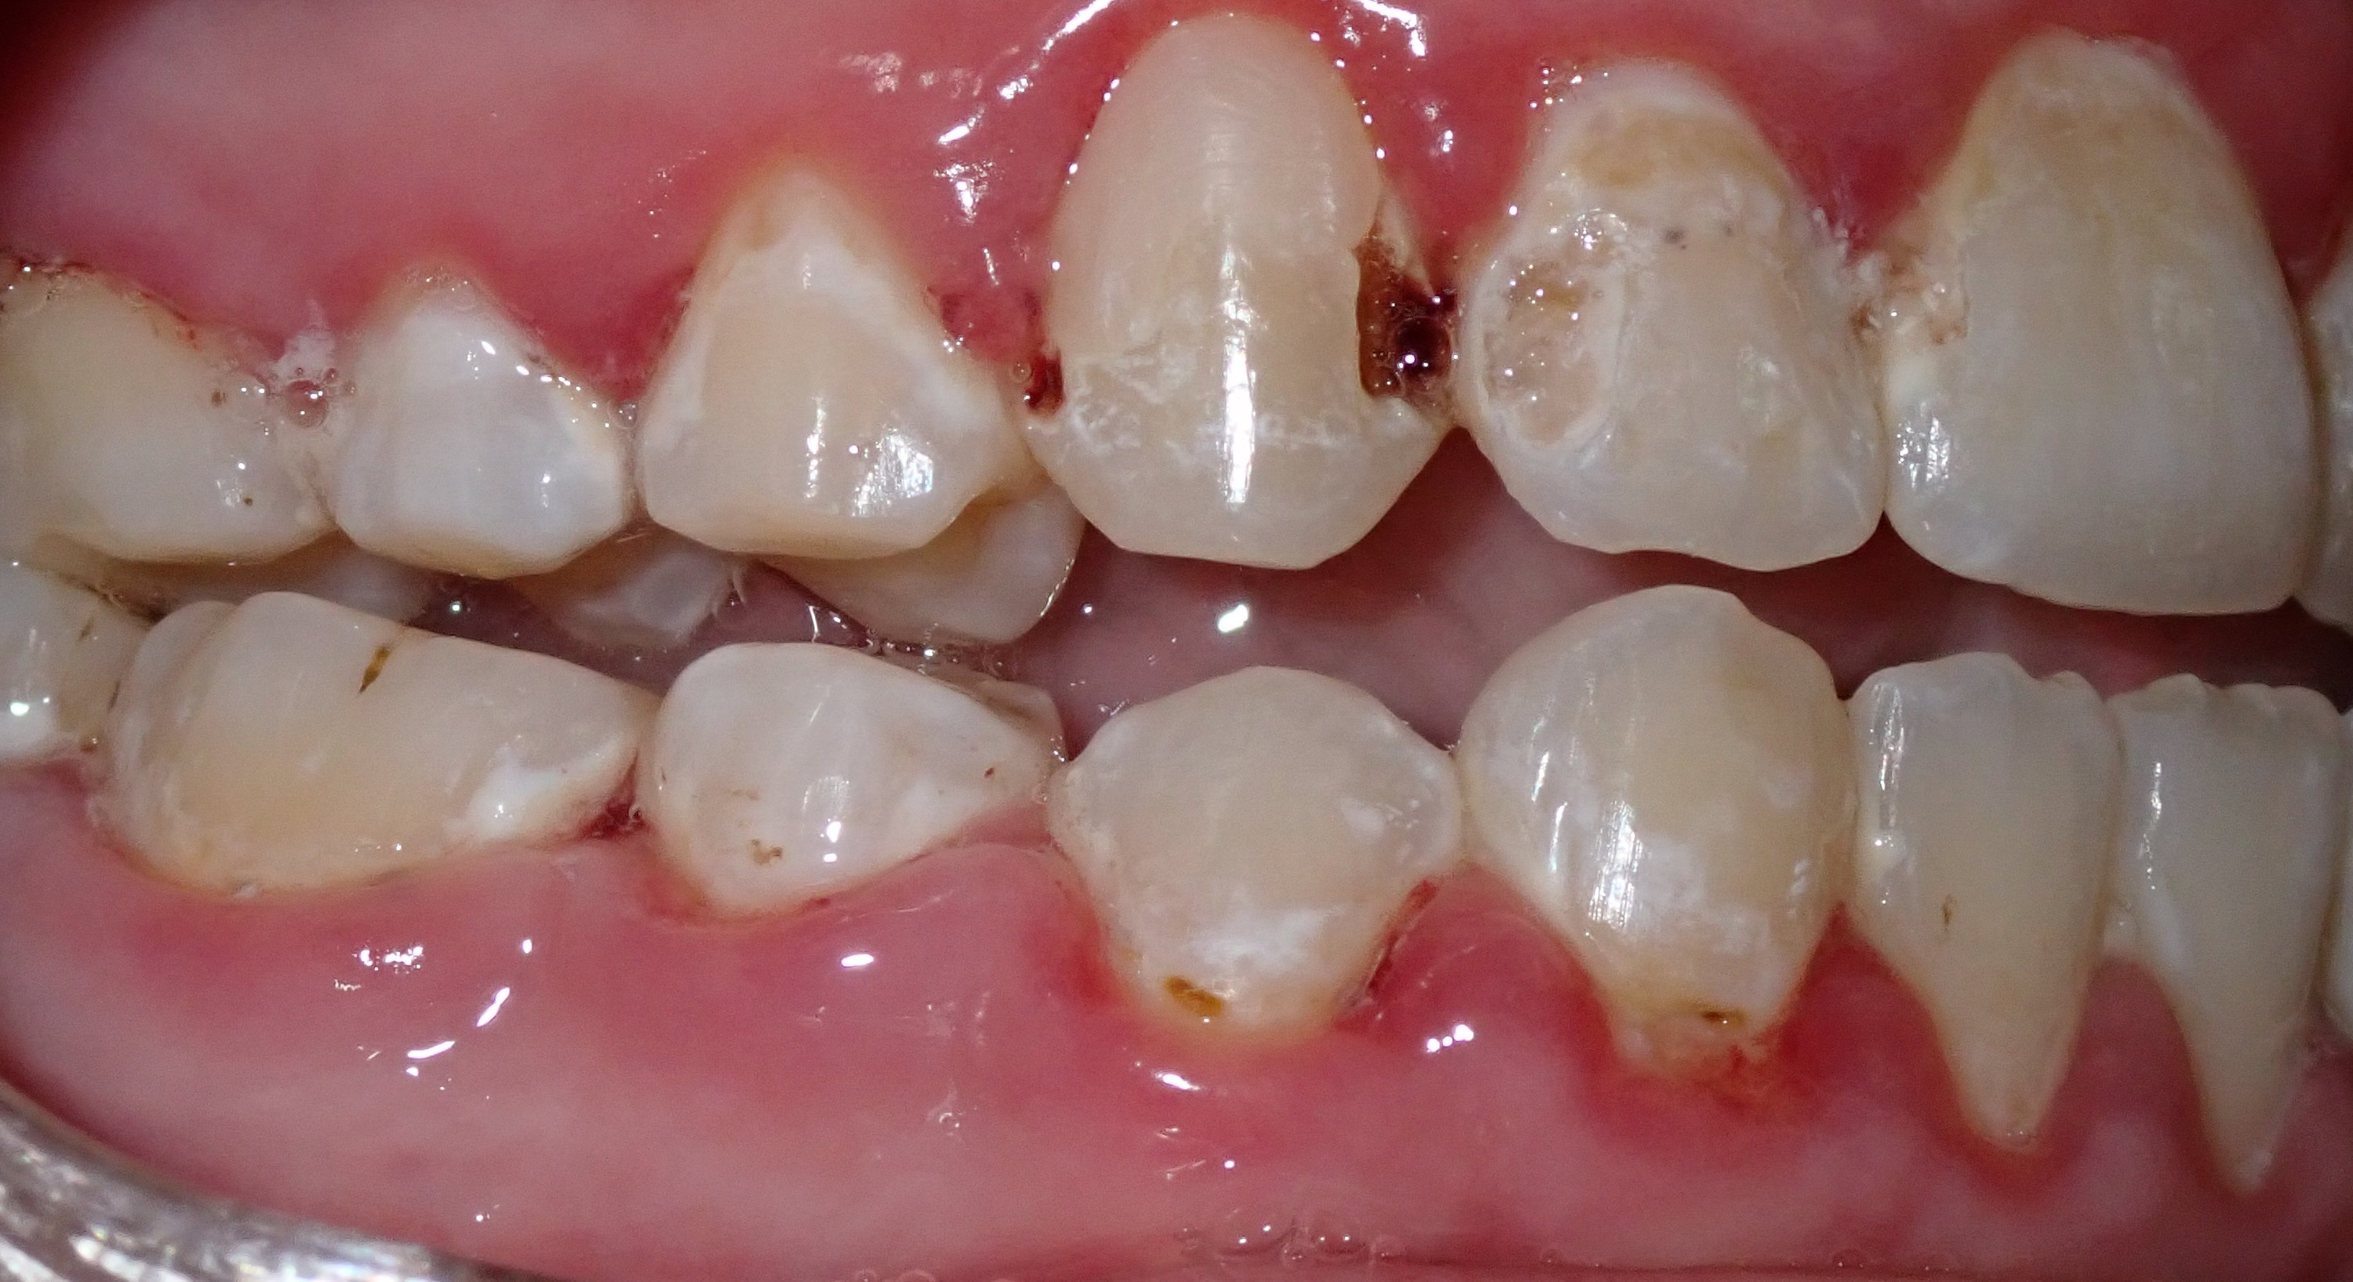
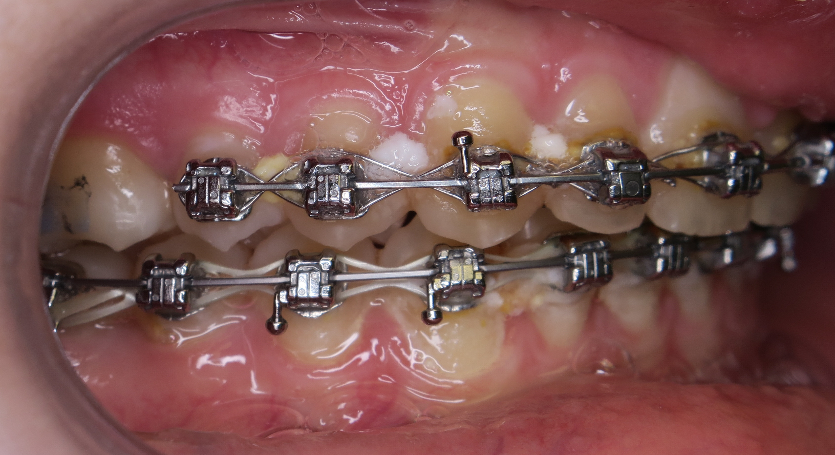
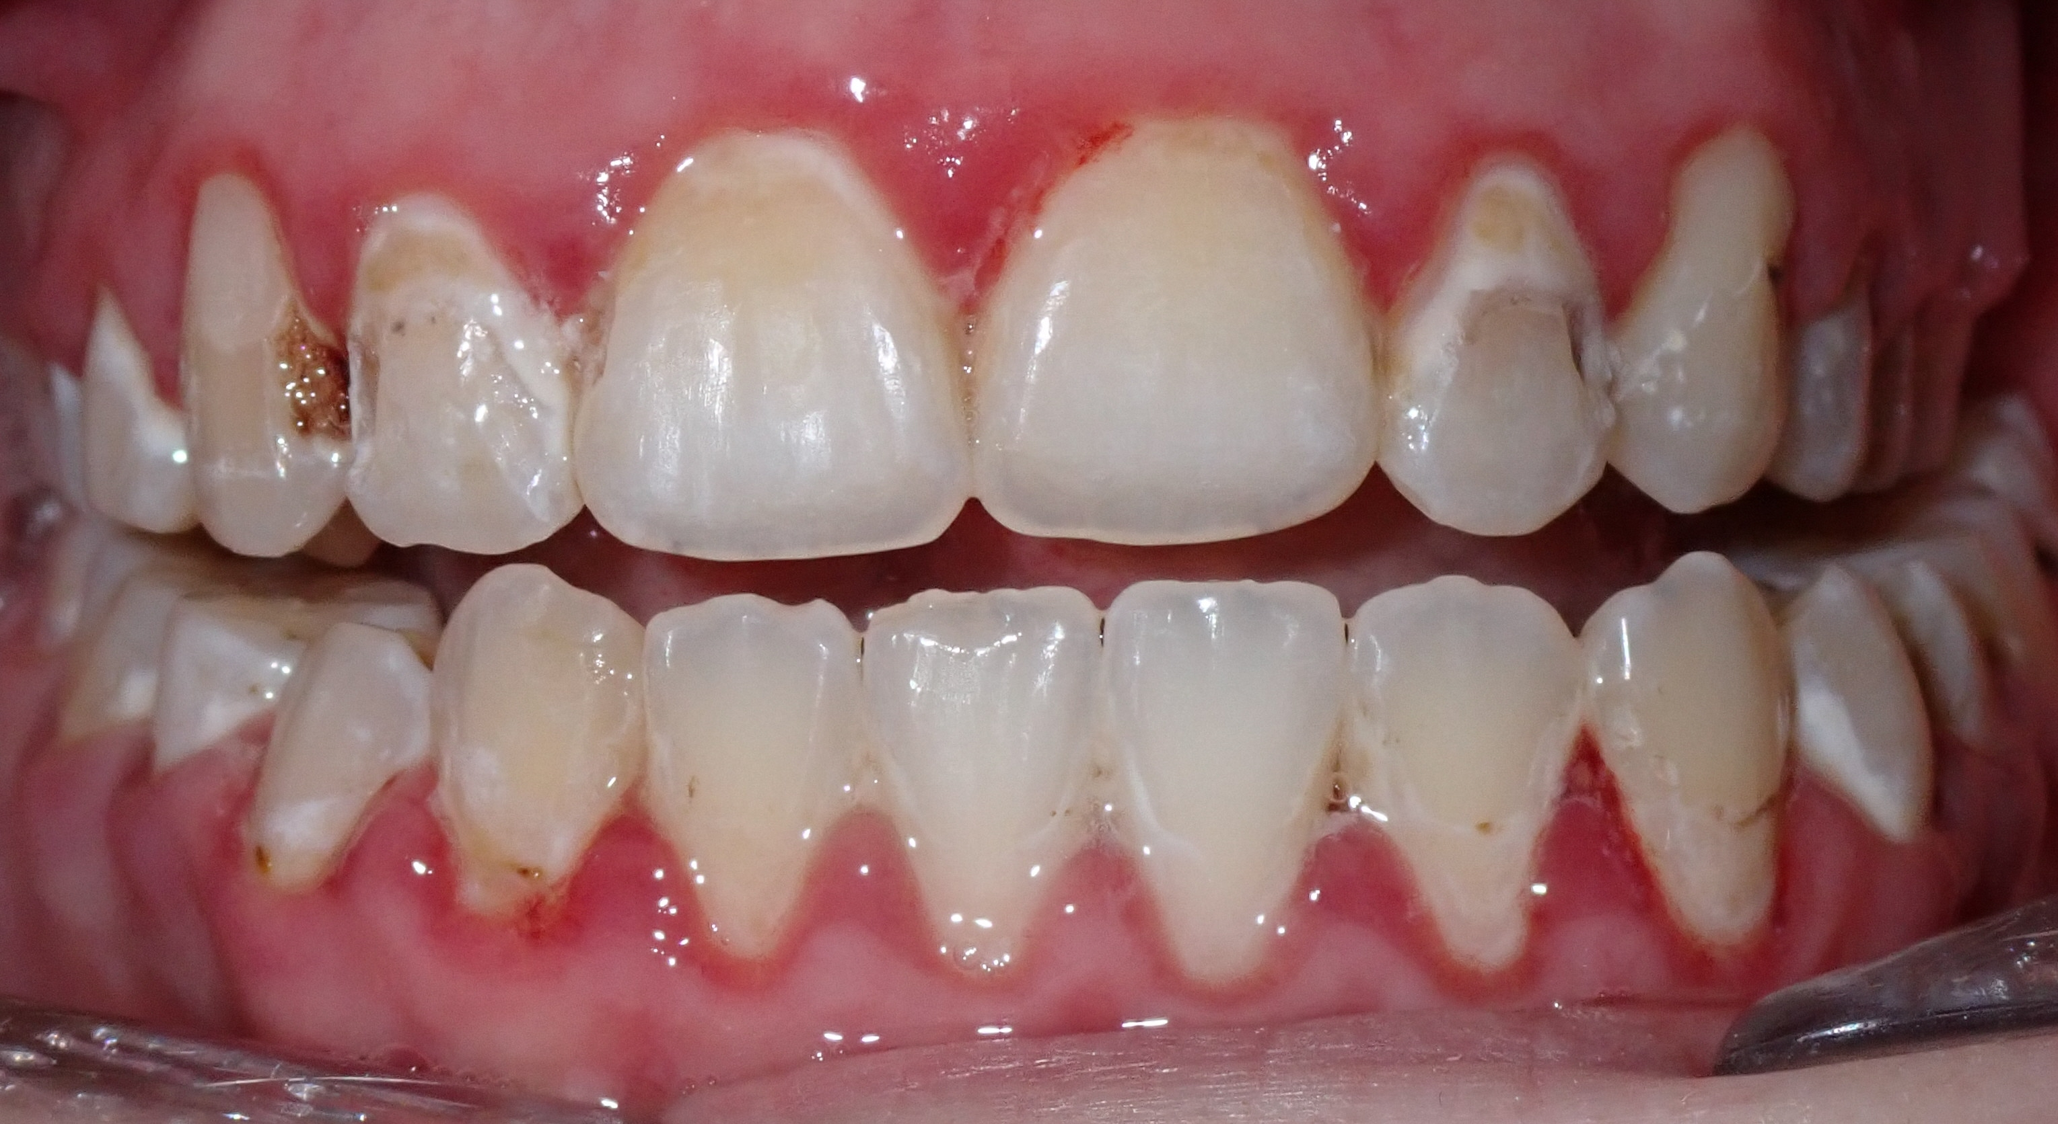
PRACTICING GOOD ORAL HYGIENE
Without brushing and flossing, PLAQUE BUILD-UP, DECAY, DECALCIFICATION, and STAINING can happen. These marks are PERMANENT and will not come off your teeth! Practicing good oral hygiene will prevent your teeth from looking like this…
Poor oral hygiene during treatment
Poor oral hygiene after finishing treatment

Slide 10
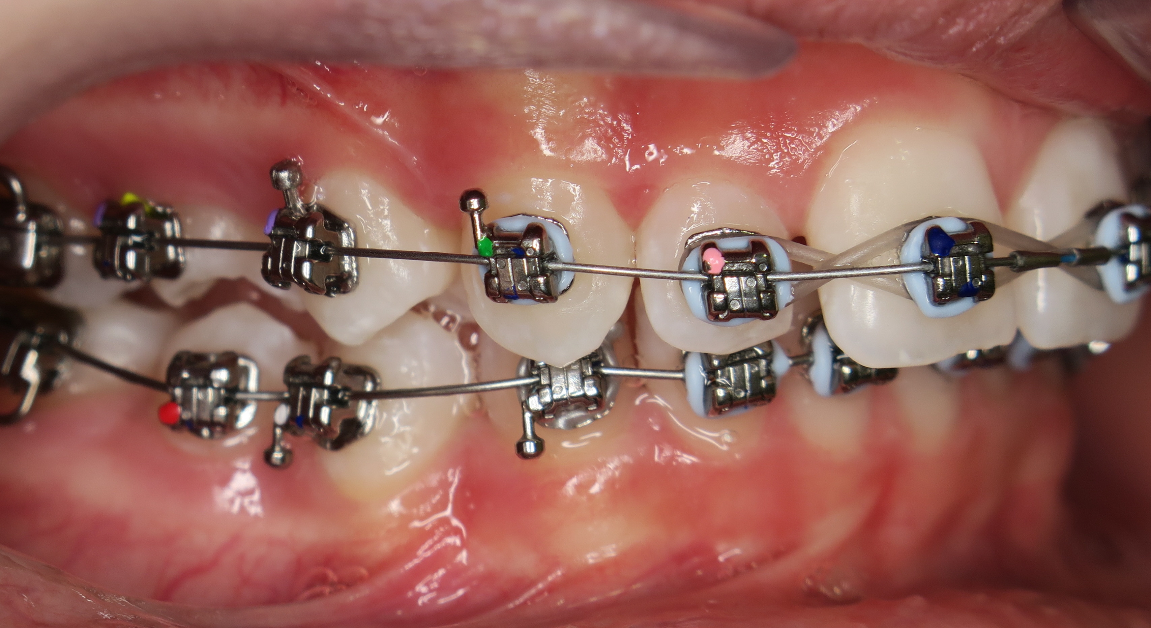
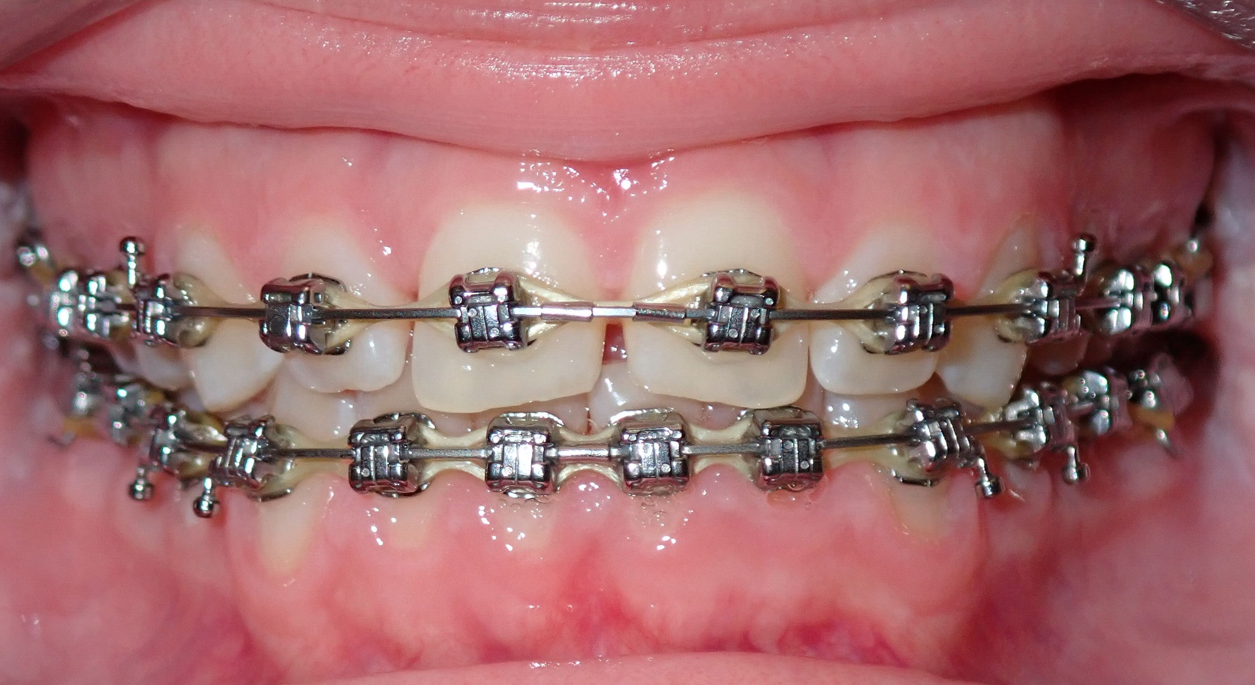
PRACTICING GOOD ORAL HYGIENE
If you brush and floss your teeth properly and consistently, use your PreviDent® toothpaste at night, and avoid sticky, chewy, and hard foods, then you will end treatment with a beautiful, healthy smile!
Effort = Results! By putting forth your best effort to practice good oral hygiene, you will get the best results.
Amazing oral hygiene during treatment

Slide 11
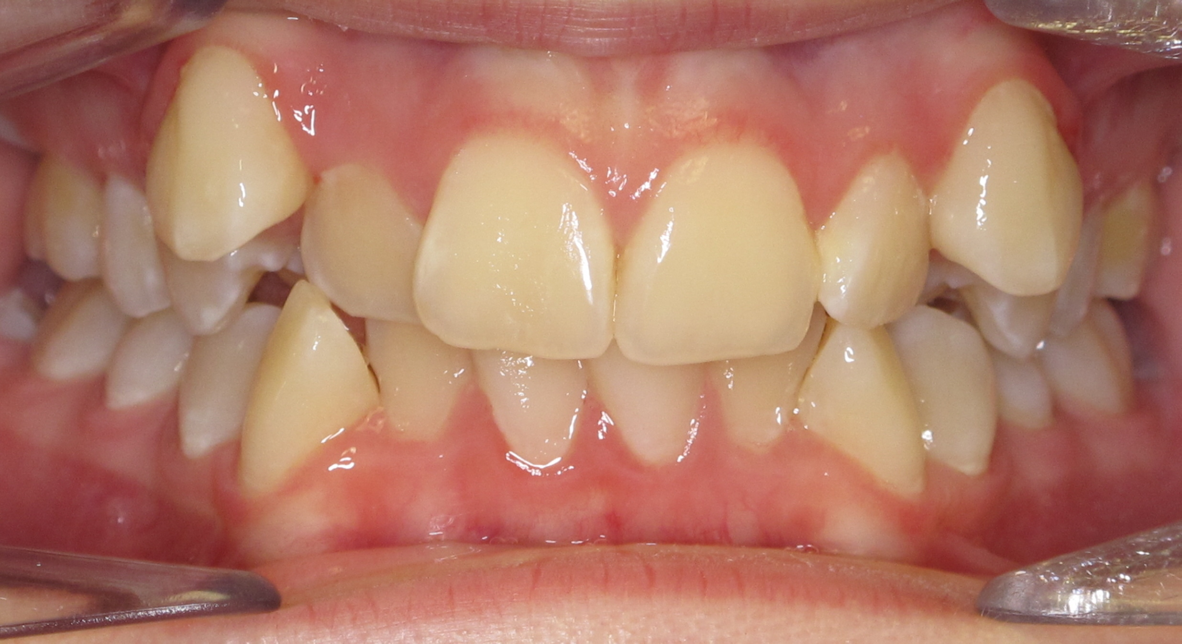
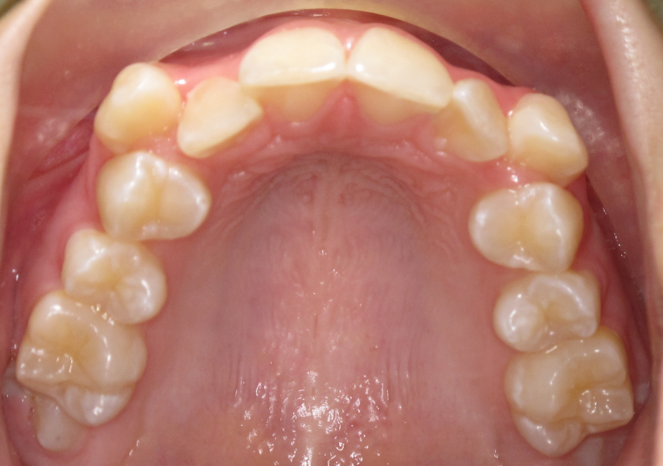
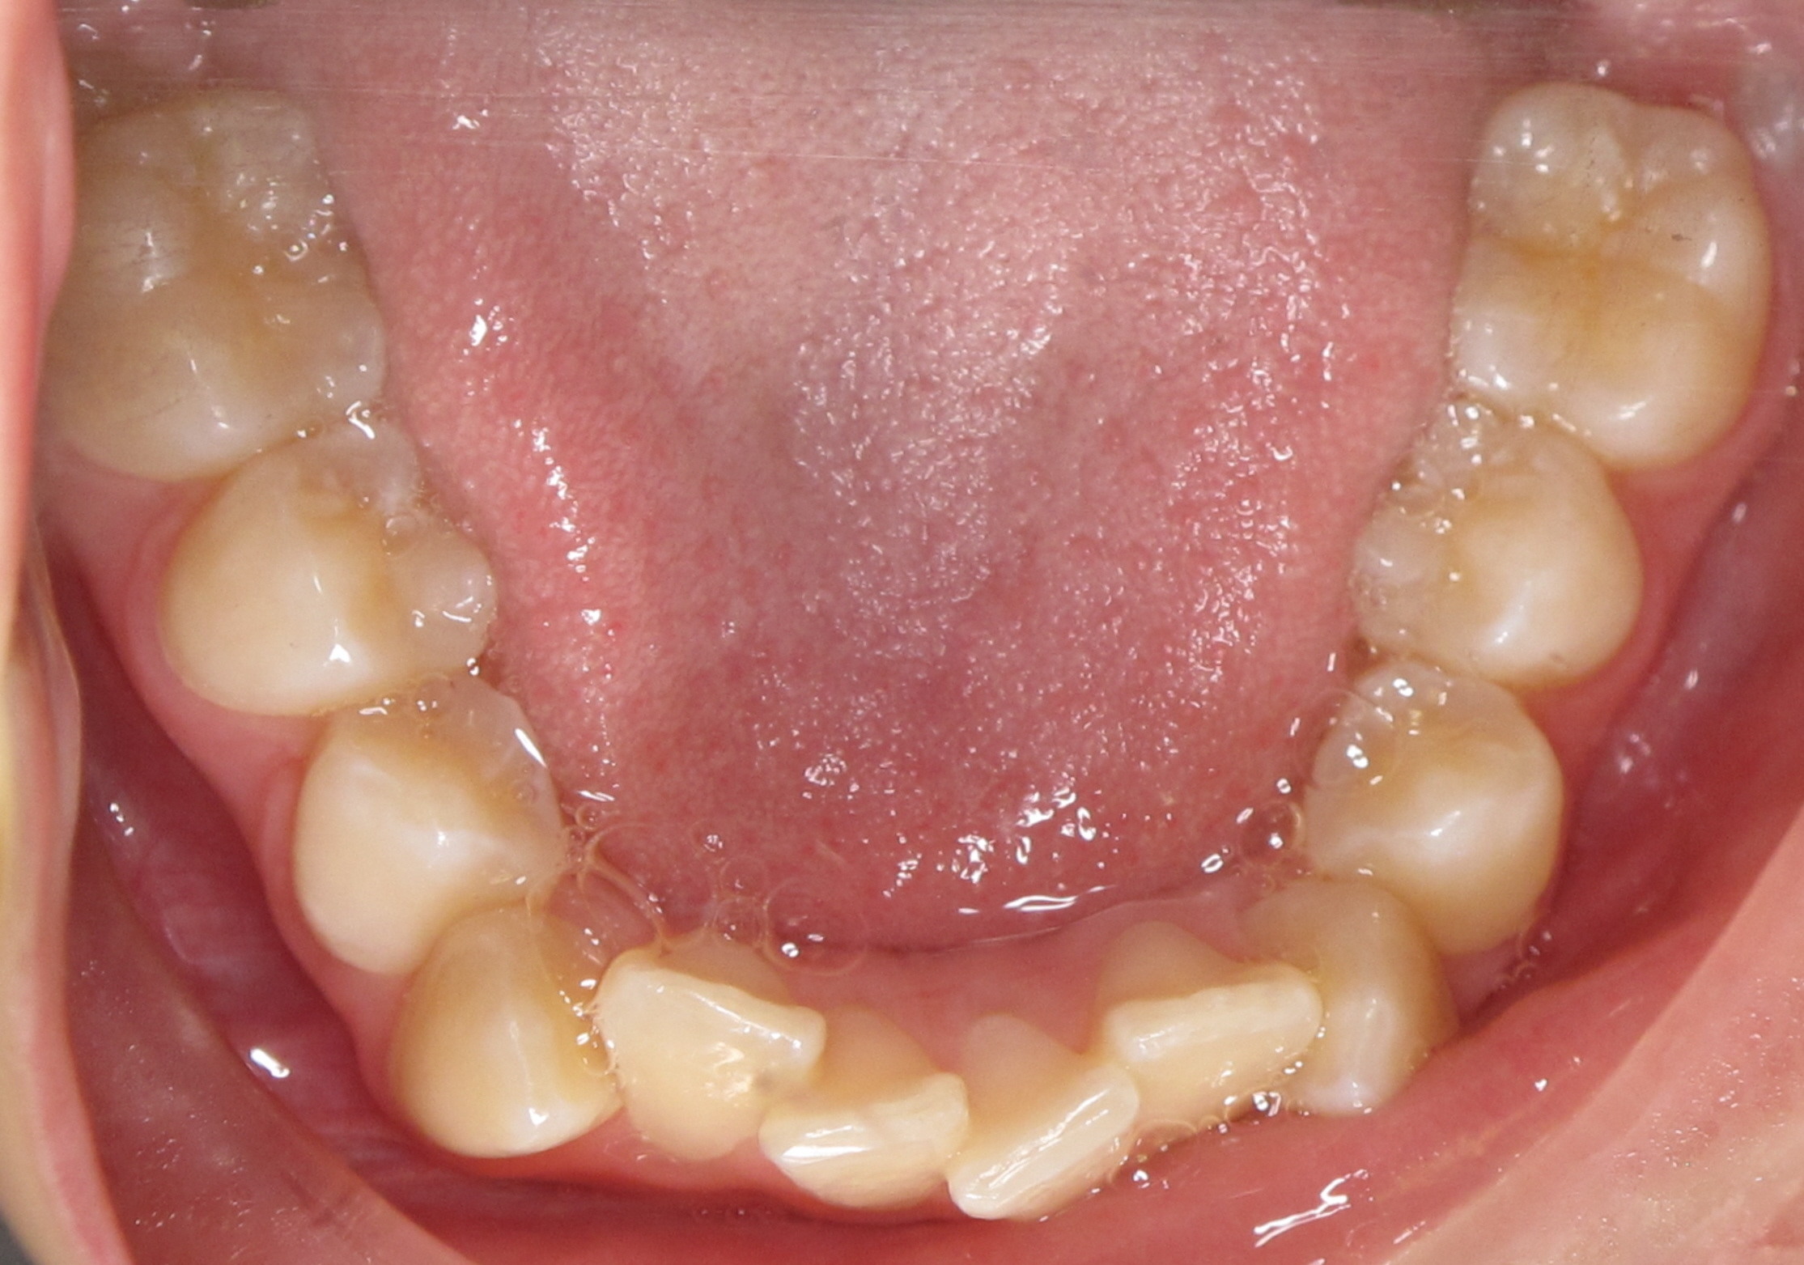
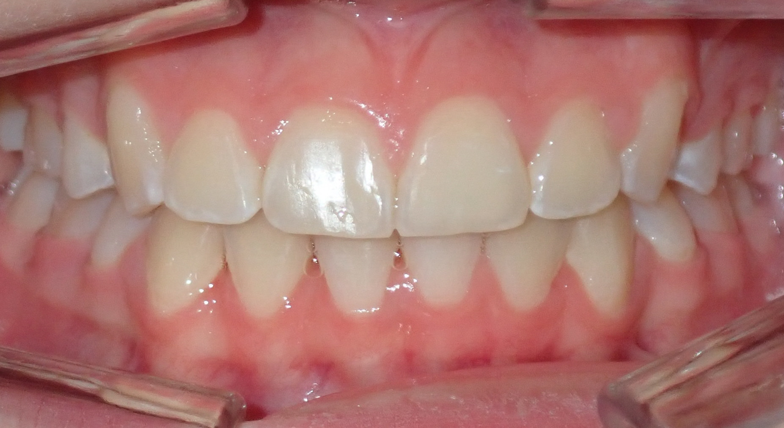
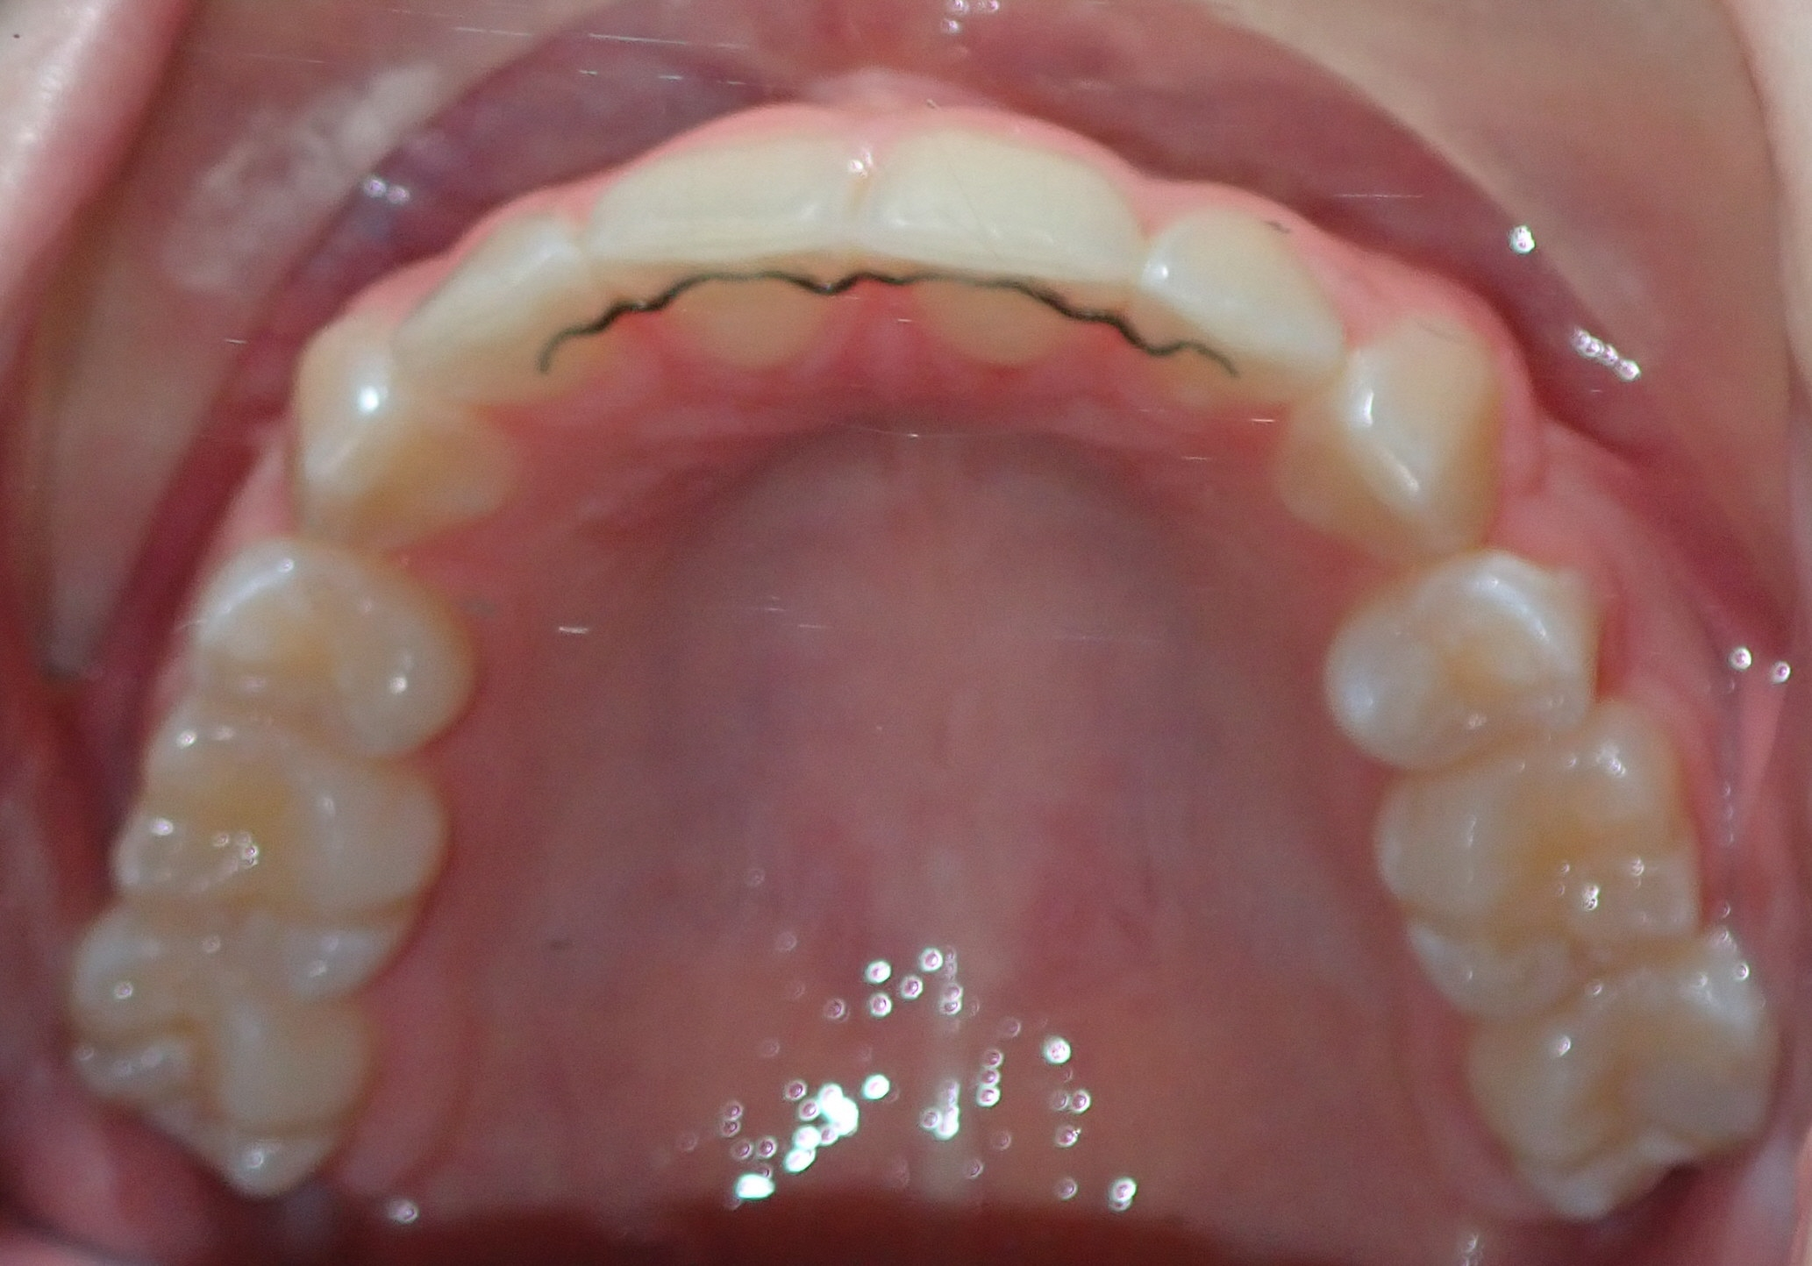
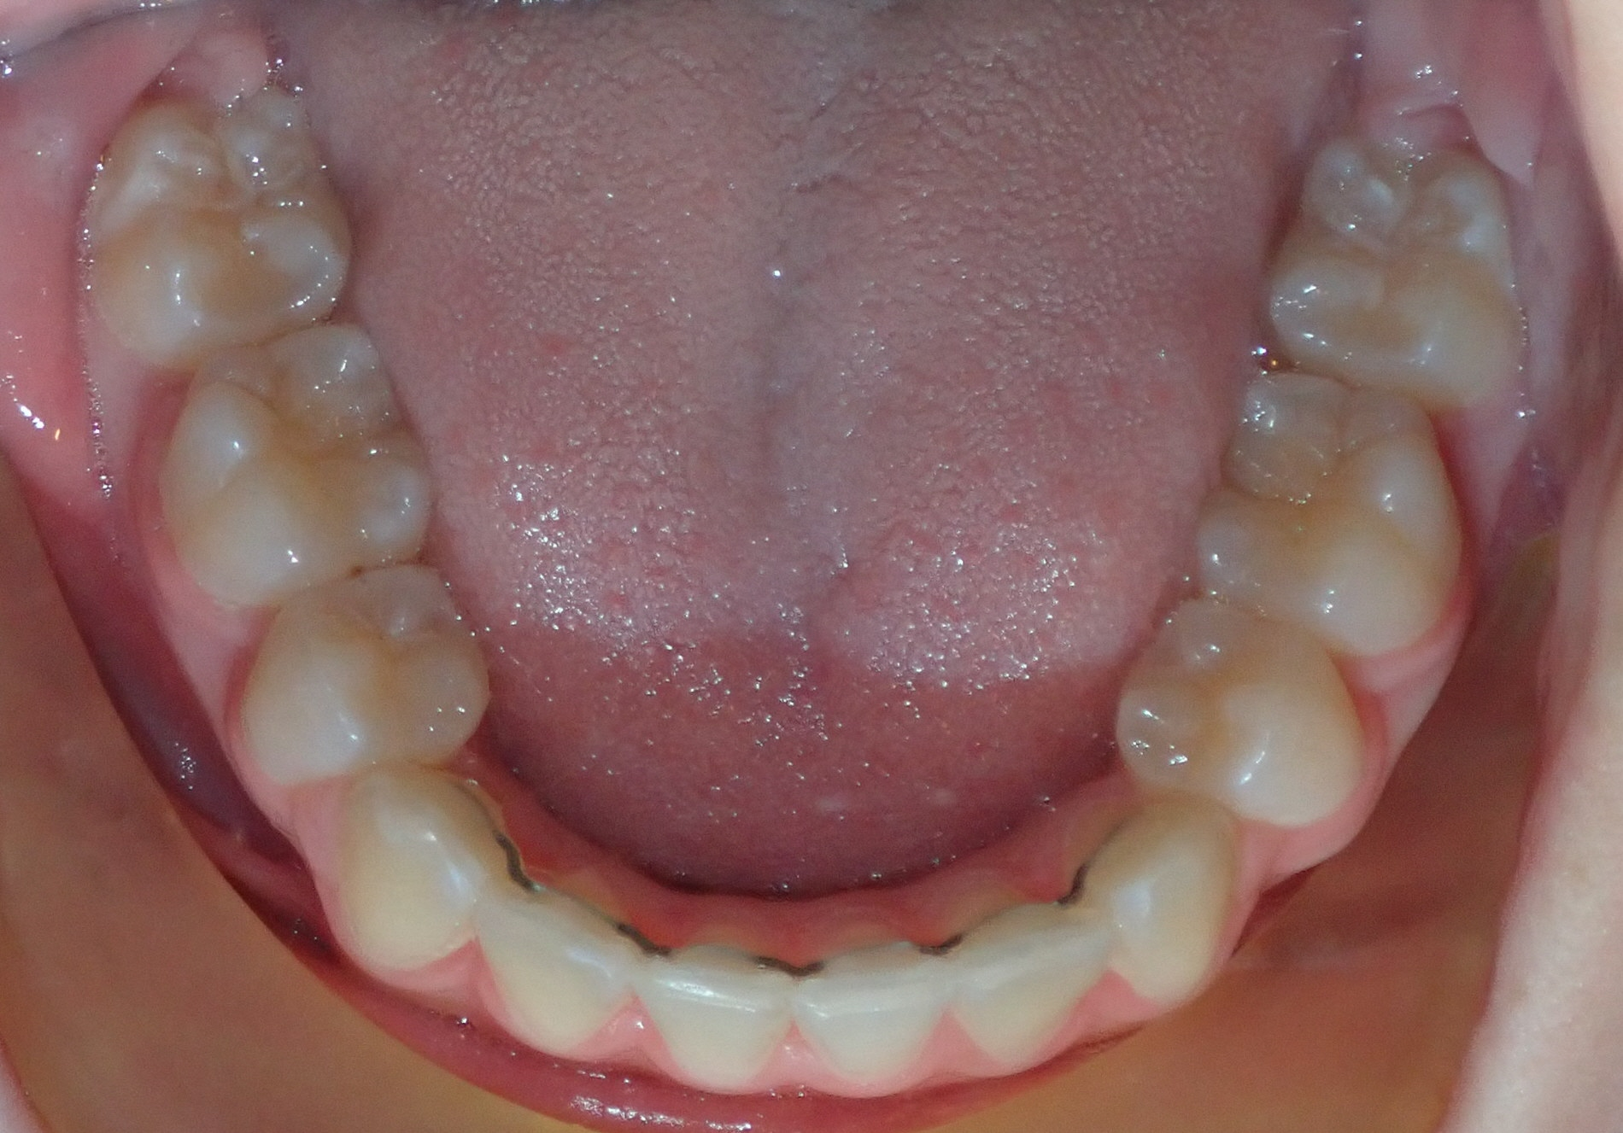
PATIENT BEFORE & AFTER FINISHING ORTHODONTIC TREATMENT WITH GOOD ORAL HYGIENE
BEFORE
AFTER

Slide 12
AT-HOME SOLUTIONS FOR SORENESS AND/OR DISCOMFORT
Initial Discomfort
Discomfort during the first few days of getting your braces is completely normal and your mouth should get used to your braces within two weeks.
To ease any discomfort, we recommend the normal dosage of over-the-counter pain reliever, such as ibuprofen or Tylenol.
For the first few days after getting your braces, eat soft foods such as pasta, macaroni and cheese, mashed potatoes, smoothies, yogurt, ice cream, and milkshakes.
It is completely normal for your bite to sometimes feel a little bit “off” during your treatment. This happens because your teeth are constantly moving to be in their correct position.

Slide 13
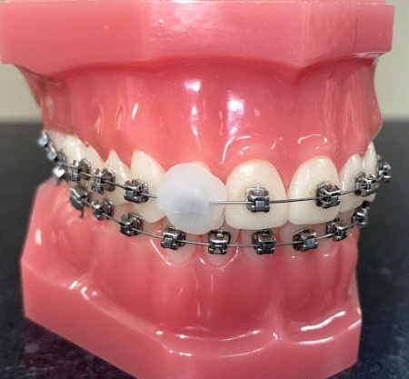
AT-HOME SOLUTIONS FOR SORENESS AND/OR DISCOMFORT
Loose Brackets
Place wax over the loose bracket to hold it in place.
If the bracket is completely out of your mouth please call our office for further direction.
Wax holding a loose bracket in place

Slide 14
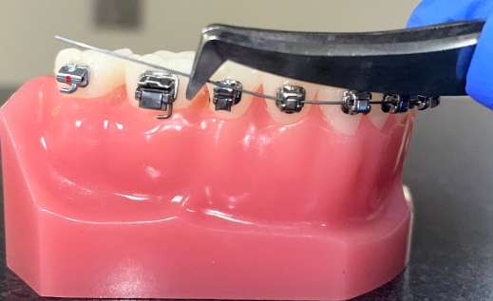
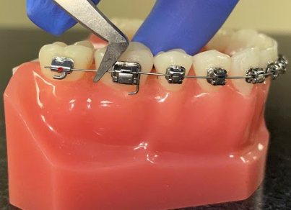
AT-HOME SOLUTIONS FOR SORENESS AND/OR DISCOMFORT
Loose Wires
Wires can be placed back through the bracket with a pair of tweezers or a small set of pliers.

Slide 15
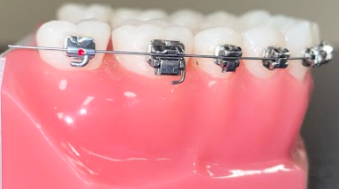
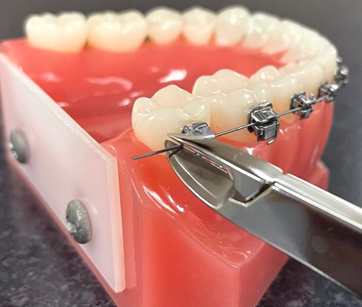
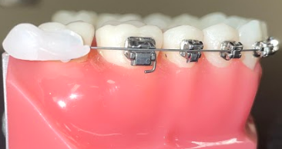
AT-HOME SOLUTIONS FOR SORENESS AND/OR DISCOMFORT
Poking Wires
If you are unable to put the wire back through a bracket, you can try to cut the wire behind the last bracket and place wax over the area.
You can also try to push or bend the long wire down with the end of a spoon or a pencil eraser.
Example of a long wire
Cover with wax if unable to clip, or cover after clipping
Clip long wire as best you can

Slide 16
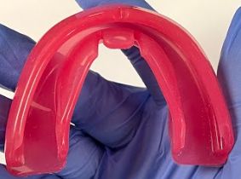
BRACES AND ACTIVITIES
Mouthguards
It is extremely important to wear a mouthguard while participating in sports. A mouthguard will protect your teeth and soft tissues from damage. For athletes currently wearing braces, we recommend purchasing a Shock Doctor© mouthguard, available at most sporting goods stores.
Shock Doctor© mouthguards are not ‘boil-and-bite’ mouthguards. They are intentionally flexible and non-moldable so that they are able to adapt to the movement of your teeth.
If you would like to get a *custom mouth guard in a color of your choice, please let us know once it gets closer to the end of your treatment!
Shock Doctor© mouth guard
*There are additional fees for custom mouth guards

Slide 17
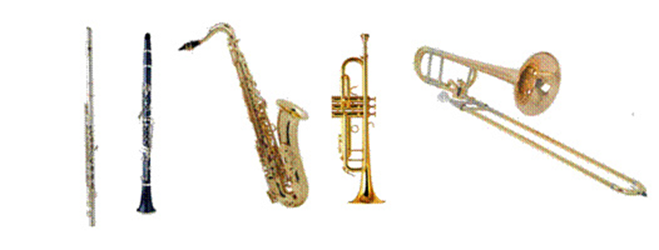
BRACES AND ACTIVITIES
Playing Instruments
It can be difficult to adjust to playing an instrument with braces, but after a week or two you should be playing fine again. If lip and cheek irritation continues, please contact our office.

Slide 18
WHAT TO EXPECT DURING YOUR TREATMENT
We will typically schedule your appointments every 8-12 weeks.
It is important to leave your braces/appliances alone so that they can do what they are supposed to do. Don’t fiddle with them!
If a bracket breaks, don’t worry, but please call us right away! We can schedule an extra care visit to have it replaced, or we may replace it at your next appointment. Please keep the bracket and bring it with you to your appointment.
Please keep in mind that these extra care visits are not always available at the most convenient times.

Slide 19
IN CASE OF AN EMERGENCY…
Clinical assistants and/or the doctors are on-call for traumatic emergencies 24/7. Injuries to the face would be considered an emergency. In the event of an emergency after normal business hours, call our office to be connected with the emergency pager service.
As a courtesy, we ask that patients and parents do not call our pager service for a non-emergent reason. Non-emergent examples would include calls to cancel or reschedule appointments, or to be seen solely for convenience outside of school or work hours. If the patient is experiencing the common soreness of orthodontic treatment such as a poking wire or if a bracket has fallen off, please refer to the At-Home Solutions page(s), and call our office during normal business hours.

Slide 20
HOW TO CONTACT US:
WATERFORD
860.443.1827
NORWICH
860.886.7777

