Slide 1
Congratulations on Completing the First Phase of Orthodontic Treatment!

Slide 2
WELCOME TO THE “RESTING PERIOD”
As you know, this initial step was taken with very specific goals in mind that we have now ACHIEVED! You are now ready to begin your “resting period”.
During this time, we will monitor your growth and development approximately every 6 months.
While we continue to keep an eye on your development, we are very likely to recommend a second phase of treatment at some point in the future.
z
z
z
z
z
z
z
z
z
z
z
z

Slide 3
WHAT TO EXPECT NOW
At the end of your appointment today you will have received a set of removable retainers. These retainers can be adjusted as needed, given that your baby teeth will naturally fall out and the remaining permanent teeth will begin to erupt.
Your retainers are very important to maintain the goals we met during your first phase of braces!
Please bring your retainer to every appointment from now on.

Slide 4
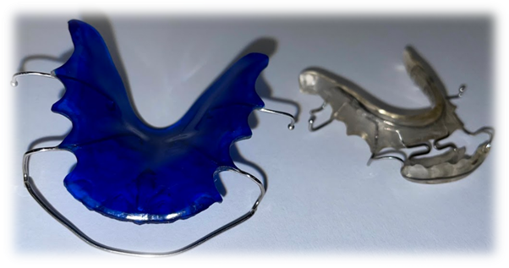
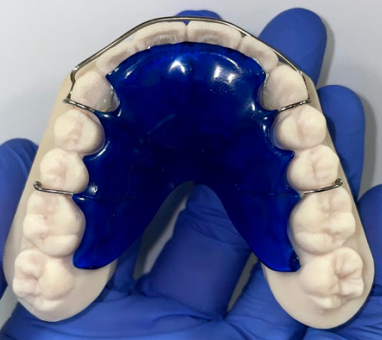
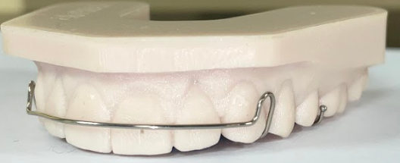
RETAINERS
Retainers are a removable appliance worn as prescribed to hold orthodontic movement. Today you received an Acrylic Hawley Retainer (ACH) to hold the alignment and expansion that we have created throughout your treatment.

Slide 5
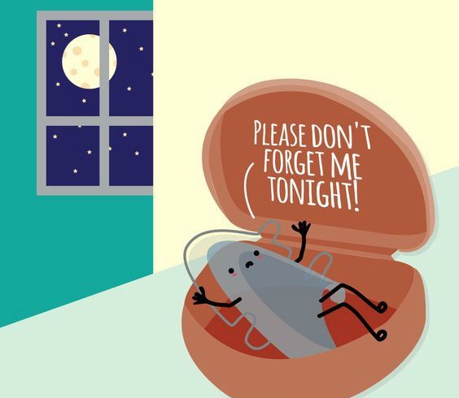
RETAINER WEAR
You must wear your retainer EVERY SINGLE NIGHT in order to maintain space and/or the new jaw relationship we have created with braces.
You must wear your retainer for the amount of hours that Dr. O’Leary or Dr. Hack have prescribed.

Slide 6
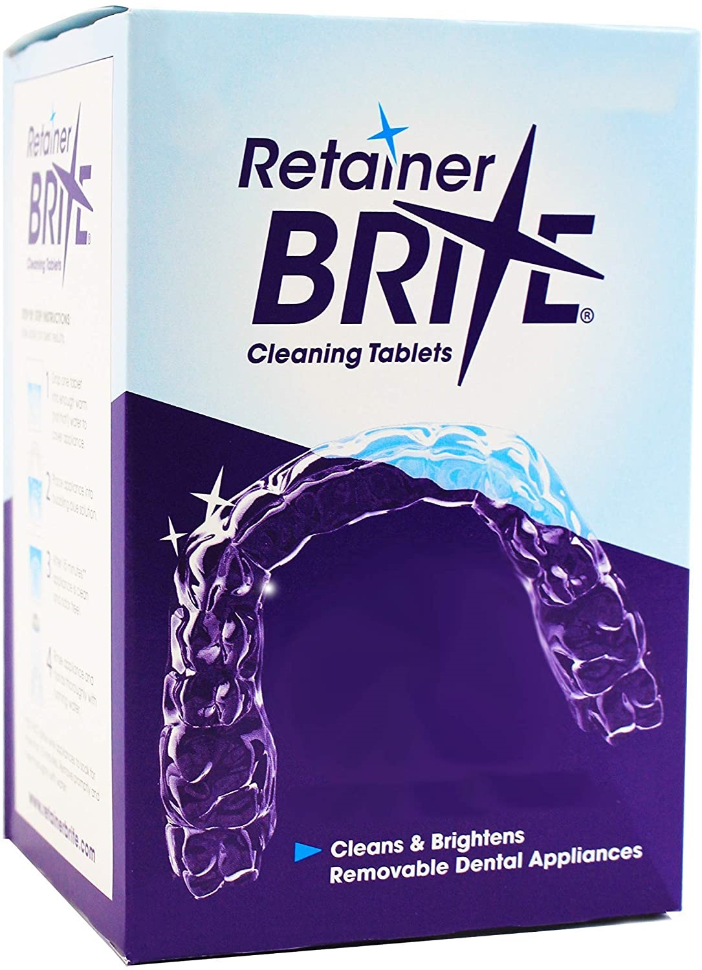
CLEANING YOUR RETAINERS
Your retainers will need to be cleaned daily- in the morning when you remove them and at night before you put them back in.
You can use a toothbrush and toothpaste or mild dish soap (like Dawn©) with lukewarm water to clean both the inside and outside of your retainers.
You can also purchase retainer cleaning tablets if needed.
Example of cleaning tablets

Slide 7
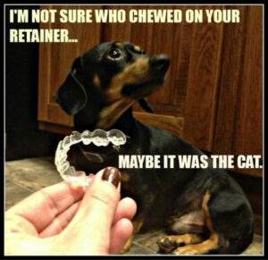
RETAINERS AND PETS
KEEP YOUR RETAINERS OUT OF REACH OF ALL PETS!!! RETAINERS ARE YOUR DOG’S MOST EXPENSIVE CHEW TOY!!
This occurs more often than you may think. Dogs and other animals can be attracted to the scent of the plastics and acrylics used, as well as your saliva. Be sure to keep your retainer in a safe space when you are not wearing it!

Slide 8
REMINDERS FOR RETAINER COMPLIANCE
DO ☺
DON’T ☹
Call us immediately if your retainer is lost, damaged, or not fitting properly
Call us immediately if a baby tooth becomes loose and prevents you from wearing the retainer
Remove your retainer while eating
Wear your retainer as instructed so your teeth don’t shift
Continue to visit your general dentist on a regular basis
Wrap your retainer in a napkin while eating
Put your retainer in your shirt or pants pocket
Leave your retainer near heat, including sunlight, heaters, a hot car, etc.
Boil, microwave, or clean your retainer with extremely hot water
Leave your retainer out of its case

Slide 9
HOW TO CONTACT US:
WATERFORD
860.443.1827
NORWICH
860.886.7777

